Slide 1
Making an Impact on Maternal Mortality and Severe Morbidity
Supported by:
California Dept. of Public Health
California Health Care Foundation
Centers for Disease Control (CDC)
Merck for Mothers Project
Yellow Chair Foundation
Elliott K. Main, MD
Medical Director, CMQCC
Professor of Obstetrics and Gynecology, Stanford University
Notes:
1

Slide 2
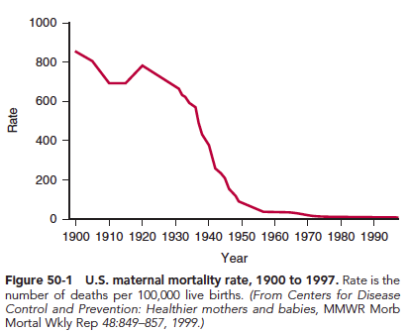
Reduction of Maternal Mortality is one of the
Greatest Public Health Success Stories of the Last Century

Slide 3
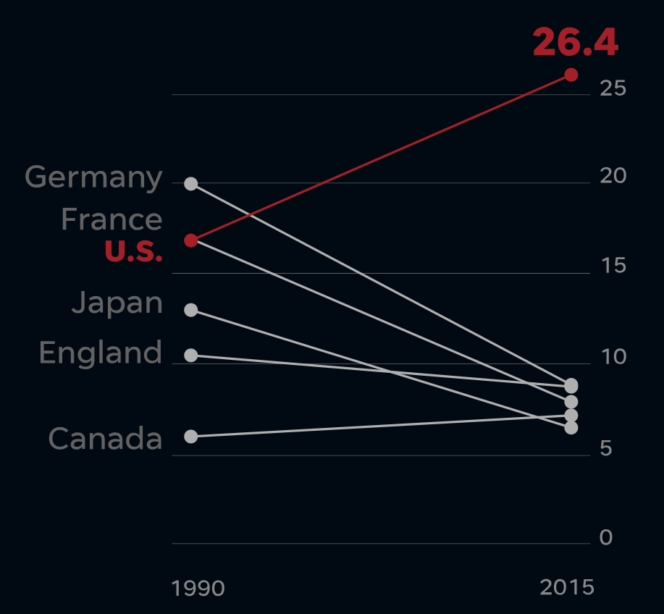
In the last 15 years, US has seen rises in:
Maternal Mortality: Up 50-70%
Severe Maternal Morbidity:
Up 100 %
Cesarean Births:
Up 50%
NCHS
17.3
CDC

Slide 4
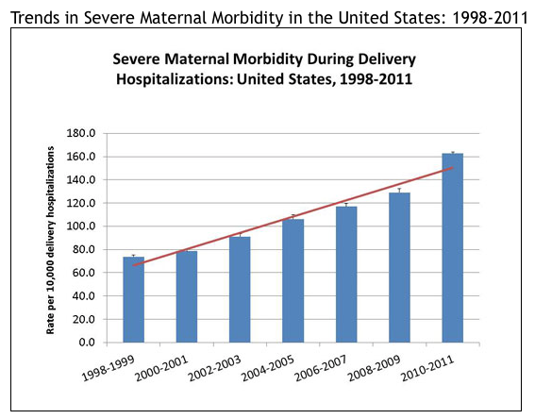
1.6%
2X
cdc.gov
Search: severe maternal morbidity

Slide 5
Maternal Mortality and Severe Morbidity
Approximate distributions, compiled from multiple studies
Cause | Mortality (1-2 per 10,000) | ICU Admit (1-2 per 1,000) | Severe Morbid (1-2 per 100)
VTE (and AFE) | 10-15% | 5% | 2%
Infection | 10-15% | 5% | 5%
Hemorrhage | 10-15% | 30% | 45%
Preeclampsia | 10-15% | 30% | 30%
Cardiac Disease | 25-30% | 20% | 10%

Slide 6
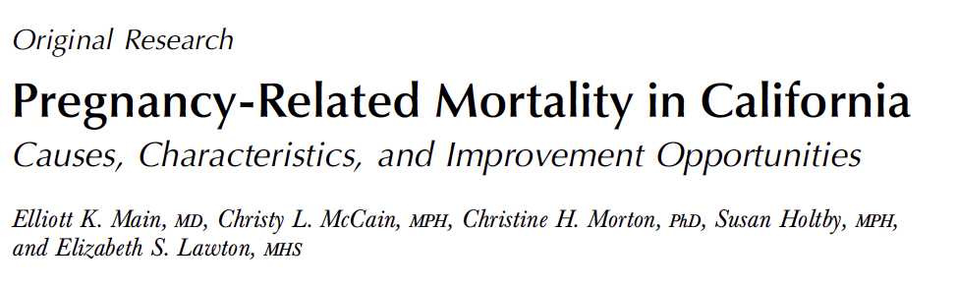




Obstetrics & Gynecology April 2015
Pregnancy-related mortality should not be considered a single clinical entity.
The five leading causes exhibit different characteristics, degrees of preventability, and contributing factors, with the greatest improvement opportunities identified for hemorrhage and preeclampsia.

Slide 7

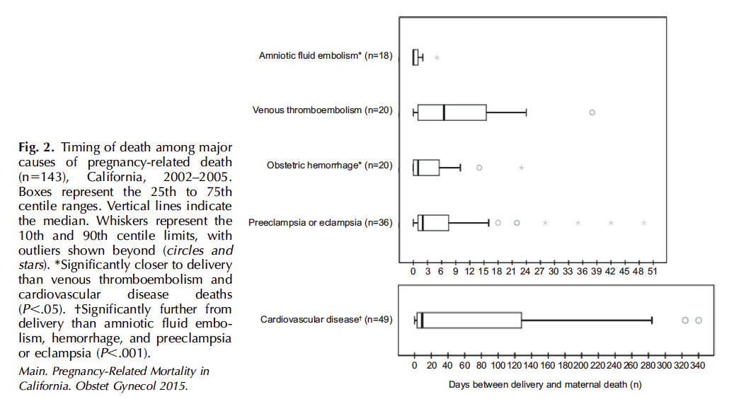
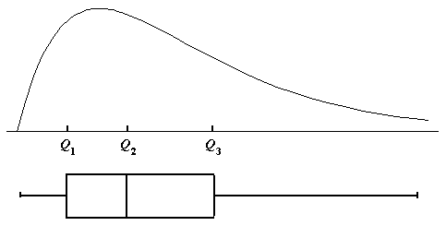
Timing of Death Among Major Causes of Maternal Mortality
AFE
VTE
OB HEM
Box and Whiskers for a Skewed Distribution
(Mean, 25th, 75%tiles)
PreE/E
25
M
75
CVD
(2/3 Cardiomyopathy and
1/3 underlying CV disease)
Main et al. Pregnancy-Related Mortality in California.
Obstet Gynecol 2015

Slide 8
Assessments of Preventability
Cause of Death | North Carolina “Preventable” | California “Good or strong chance to alter the outcome” | United Kingdom “Substandard care that had a major contribution”
Hemorrhage | 93% | 70% | 44%
Preeclampsia | 60% | 60% | 64%
Sepsis / Infection | 43% | 50% | 46%
DVT / VTE | 17% | 50% | 33%
Cardiomyopathy | 22% | 29% | 25%
AFE | 0% | 0% | 15%

Slide 9
Key Provider QI Opportunities:
Hemorrhage and Preeclampsia
California Pregnancy Associated Mortality Reviews
  Missed triggers/risk factors: abnormal vital signs, pain,
  altered mental status/lack of planning for at risk patients
  Underutilization of key medications and treatments—did not have a plan!
  Difficulties getting physician to the bedside
  “Location of care” issues involving Postpartum, ED and PACU
University of Illinois Regional Perinatal Network
  Failure to identify high-risk status
  Incomplete or inappropriate management
Present in >95% of cases
Present in >90% of cases
CDPH/CMQCC/PHI. The California Pregnancy-Associated Mortality Review (CA-PAMR): Report from 2002 and 2003 Maternal Death Reviews. 2011 (available at: CMQCC.org)
Geller SE etal. The continuum of maternal morbidity and mortality: Factors associated with severity. Am J Obstet Gynecol 2004; 191: 939-44.

Slide 10
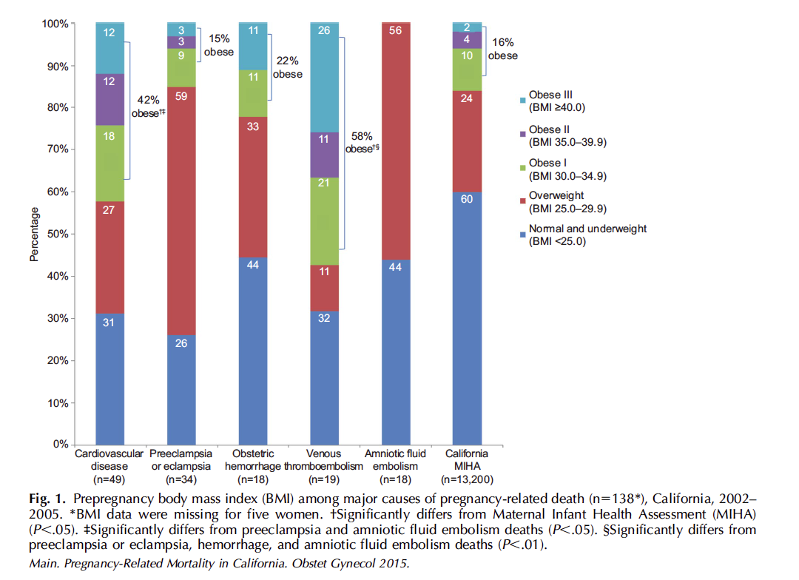
Pre-pregnancy BMI Among Major Causes of Death
Only two causes had high rates of obesity
Main et al. Pregnancy-Related Mortality in California.
Obstet Gynecol 2015

Slide 11
Obstetric Hemorrhage and Preeclampsia: Summary
Most common preventable causes of maternal mortality
Far and away the most common causes of Severe Maternal Morbidity
High rates of provider
“quality improvement opportunities”
Denial
Delay

Slide 12


Slide 13
Maternal Mortality Rate,
California and United States; 1999-2013
California: ~500,000 annual births, 1/8 of all US births
Maternal Deaths per 100,000 Live Births
CA Mortality Review Committee

Slide 14
Key Steps for Improving Care “At Scale”
Linking public health surveillance to actions
Mobilizing a broad range of public and private partners
Developing a rapid-cycle Maternal Data Center to support and sustain QI projects
Implementing a series of data-driven large-scale quality improvement projects
Main etal: Health Affairs 2018; 37:1484-93

Slide 15
CMQCC’s Key Stakeholders/ Partners
State Agencies
CA Department of Public Health, MCAH
Regional Perinatal Programs of California (RPPC)
DHCS: Medi-Cal
Office of Vital Records
Office of Statewide Health Planning and Development (OSHPD)
Covered California
Membership Associations
Hospital Quality Institute (HQI)/
California Hospital Association (CHA)
Pacific Business Group on Health (PBGH)
Integrated Healthcare Association (IHA)
Key Medical and Nursing Leaders
UC, Kaiser (N&S), Sutter, Sharp, Dignity Health, Scripps, Providence, Public hospitals
Professional Groups (California sections of national organizations)
American College of Obstetrics and Gynecology (ACOG)
Association of Women’s Health, Obstetric and Neonatal Nurses (AWHONN)
American College of Nurse Midwives (ACNM)
American Academy of Family Physicians (AAFP)
Public and Consumer Groups
Consumers’ Union
March of Dimes (MOD)
California HealthCare Foundation (CHCF)
Cal Hospital Compare
Amniotic Fluid Embolism Foundation
Health Plans
Commercial and Managed Medi-Cal Plans
15

Slide 16
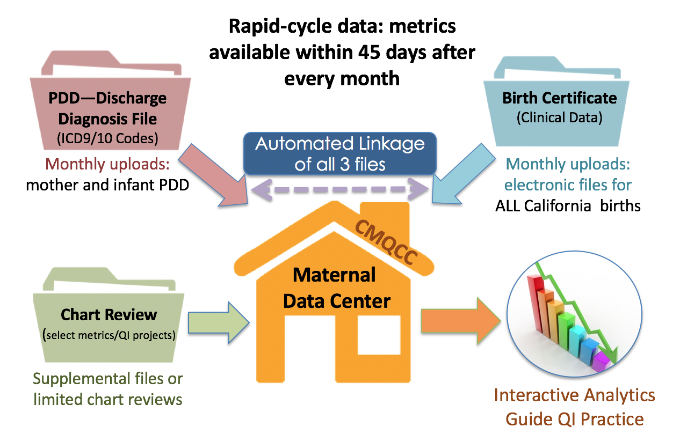
CMQCC Maternal Data Center
Links over 1,000,000 mother/baby records each year!

Slide 17
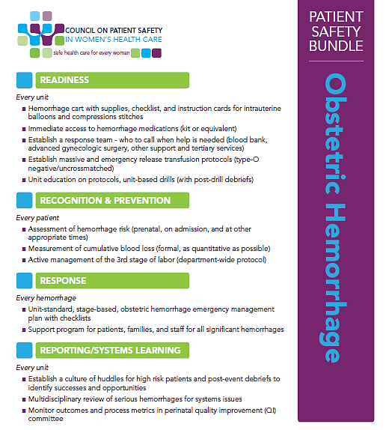
Maternal Safety Bundles
What are they?
“Checklist” of items and practices for every birthing site
Not a national protocol !!
Facilities will modify content based on local resources
Uniform Structure:
Readiness
  Every unit—prepare and educate
Recognition & Prevention
  Every patient—before event
Response
  Every Event—team approach
Reporting/Systems Learning
  Every unit—systems improvement
Available (with resource links) at: safehealthcareforeverywoman.org

Slide 18

OB Hemorrhage - Readiness
Every unit
Hemorrhage cart with supplies, checklist, instruction cards and posters
Immediate access to hemorrhage medications
Establish a response team – who to call when help is needed
Establish massive and emergency release transfusion protocol/policies
Unit education on processes, unit-based drills (with debriefs)
Easy Steps: Just the Beginning!

Slide 19
“Just in Time” Education
Put into the hands of doctors, midwives and nurses key information… at the moment of its use (Cart)
Response Education
  Management Plan with checklist (reminders)
  Uterotonic Medication Guide: pros and cons
  How To Do: Steps to place an intrauterine balloon
  How To Do: B-Lynch Suture
  Blood Product Information
Notes:
Corresponding areas within the toolkit (we can be more specific very soon when the 2.0 version receives final approval from the state)

Slide 20
How to Quantify Blood Loss
Don’t get stuck arguing about weighing every pad and every clot (some folks have mastered this!)
Stick with the principles: Intentional and Cumulative
  Under-buttock drapes and suction canisters
  Train to look and estimate pads and clots
  Keep running EBL (cumulative), especially for recovery/PP
Cumulative Blood Loss is a key component to the plan

Slide 21
OB Hemorrhage
Response
Every hemorrhage
Obstetric hemorrhage emergency management plan
  Unit-standard,
  Includes Evaluation steps
  Stage-based (dependent on QBL)
  With checklists
Support program for patients, families, and staff for all significant hemorrhages
21

Slide 22
Stage-Based Approach to PPH
Stage O | All Births
Stage 1 | >500 mL VD or >1000 mL CD Brisk bleeding, large gush, large clots, boggy uterus
Stage 2 | Continued bleeding, VS instability or symptomatic (mental status can be telling) AND <1500 mL cumulative blood loss
Stage 3 | Cumulative QBL> 1500 mL with bleeding ≥ 2 units PRBCs given Coagulopathy suspected
Notes:
With stage-based protocols, specific clinical interventions are linked to each stage of hemorrhage.

Slide 23
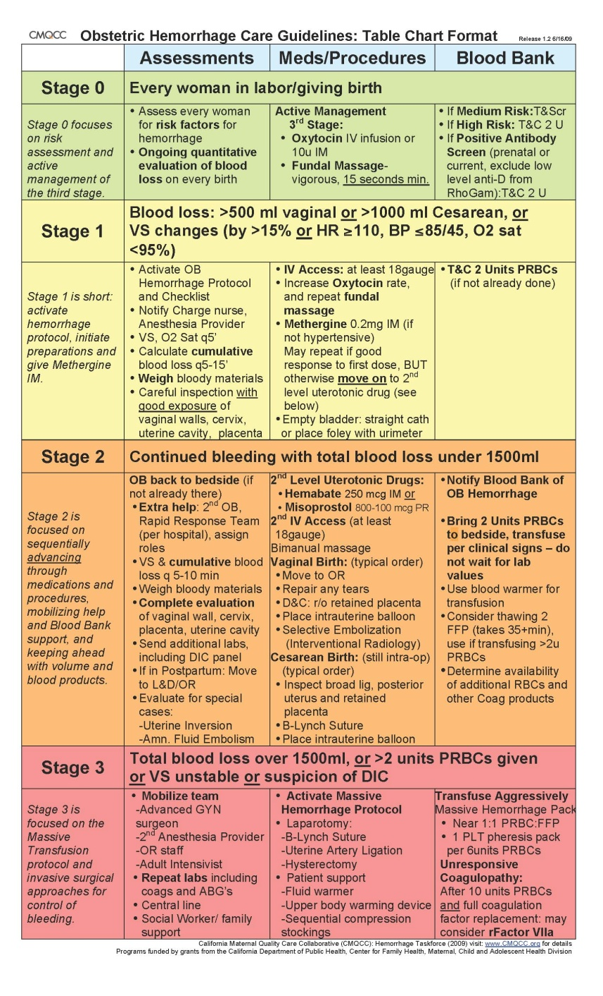
Example Hemorrhage Emergency Response Plan
Tools are adapted for each hospital's resources
Denial
Delay
www.CMQCC.org

Slide 24
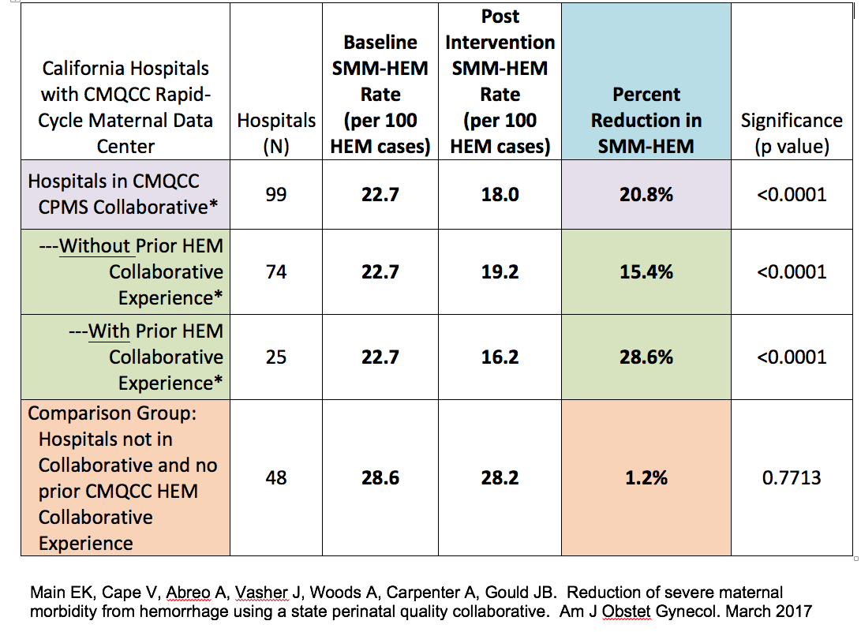
Reduction in Severe Maternal Morbidity From HEM
With a Large (99) Hospital Quality Collaborative
(>300,000 patients)

Slide 25
Preeclampsia
Toolkits and Safety Bundles
  CMQCC Preeclampsia Toolkit: 2014
  Council on Patient Safety in Women’s Health Safety Bundle: 2017
Early treatment of severe HTN decreases SMM and eclampsia
(Shields, AJOG 2017)
  Adoption of CMQCC toolkit at 23 hospitals
    Focused on early recognition and treatment, MgS04, PP follow up
  Eclampsia decreased by 43%, SMM decreased by 29%
  Intensive monitoring of HTN treatment metrics necessary to cause change (in practice and outcome)
    Successful QI requires monitoring, clear metrics

Slide 26
CA-PAMR Final Cause of Death Among Preeclampsia Cases, (n=25)
Final Cause of Death | Number | % | Rate/100,000
Stroke Hemorrhagic Thrombotic | 16 14 2 | 64.0% (87.5%) (12.5%) | 1.0
Hepatic (liver) Failure | 4 | 16.0% | .25
Cardiac Failure | 2 | 8.0%
Hemorrhage/DIC | 1 | 4.0%
Multi-organ failure | 1 | 4.0%
ARDS | 1 | 4.0%
Notes:
16 of the 25 women or 64% of the deaths were due to strokes, with 87.5% being hemorrhagic stroke.
As we will see in the analysis of quality improvement opportunities, the greatest opportunity to prevent maternal deaths from preeclampsia is to prevent stroke. In order to to this it is imperative to recognize and appropriately treat systolic and diastolic hypertension in a timely manner.

Slide 27
Preventing Stroke from Preeclampsia
Blood Pressure Comparisons: Baseline and Pre-stroke
Measure | Pregnancy Baseline (mm Hg) | Pre-stroke (mm Hg)
Mean systolic BP | 110.9 + 10.7 (n=25) | 175.4 + 9.7 (n=24)
Systolic BP range | 90-136 | 159-198
Systolic BP % > 160 | 0 | 95.8 (n=27/28)
Mean diastolic BP | 67.4 + 6.5 (n=25) | 98.0 + 9.0 (n=24)
Diastolic BP range | 58-80 | 81-113
Diastolic BP % > 110 | 0 | 12.5 (n=3)
Diastolic BP 5 > 105 | 0 | 20.8 (n=5)
Adapted from Martin JN, Thigpen BD, Moore RC, Rose CH, Cushman J, May. Stroke and Severe Preeclampsia and Eclampsia: A Paradigm Shift Focusing on Systolic Blood Pressure, OG 2005;105-246.

Slide 28
“Treat the Damn Blood Pressure!”
Controlling blood pressure
is the key intervention
to prevent deaths due to stroke
in women with preeclampsia.
Over the last decade, the UK has focused QI efforts on aggressive treatment of both systolic and diastolic blood pressure and has demonstrated a reduction in deaths.

Slide 29
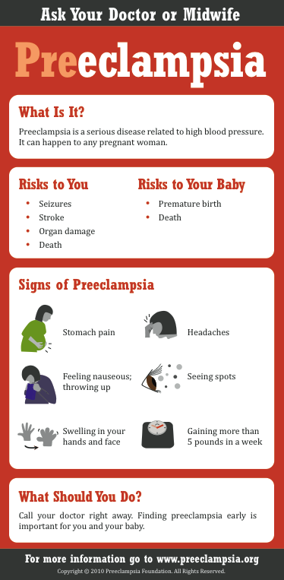
Patient Education Materials
This and many other patient education materials in English and Spanish can be ordered from www.preeclampsia.org/market-place
Notes:
Here is an example of patient education materials from the Preeclampsia Foundation.

Slide 30
Severe Maternal Hypertension
Treated Within 60 Minutes
Increased 41% to 82%
Change per Month, aOR = 1.11, 95% CI 1.10-1.12
P < 0.001
71%
Notes:
The next 4 slides show improvement in our process measures across the initiative from baseline in 2015 to October 2017. All 4 slides have a similar format. The blue line represents the percentage of women with severe HTN meeting the specific process measure each month across all participating hospitals. The green bars reflect the proportion of hospitals that achieved the accompanying project AIM goal each month.
This graph shows THAT the percentage of women with severe maternal hypertension treated within 60 minutes increased from 41% at baseline to 82% by October 2017. A trend analysis adjusted for hospital characteristics showed significant improvement across the initiative with an OR of 1.11, representing an 11% improvement per month. The green bars show that by October 2017, 71% of participating hospitals achieved the time to treatment goal of 80% or more of women treated within 60 minutes, up from 13% at baseline.
Given our goal to help all hospitals succeed, we compared the proportion of hospitals achieving time to treatment goals by hospital characteristics and found no significant differences by urban vs rural location, birth volume or patient race/ethnicity or Medicaid mix.

Slide 31
Severe Maternal Hypertension with Severe Maternal Morbidity Reported
Monthly change, aOR=0.98, 95% CI 0.96-0.99
P < 0.004
15% baseline to 9% last quarter
41% reduction
*When adjusted for hospital characteristics results were unchanged
Notes:
Shown here are the rates of Severe Maternal Morbidity over time. As can be seen there is a reduction in Severe Maternal Morbidity from 15% at baseline for the last quarter of 2015 to 9% for August through October 2017. The trend analysis showed a 2% reduction in SMM per month and an overall reduction of 41%
These results remained significant after adjusting for hospital characteristics and patient race.

Slide 32
Maternal Mortality Rate,
California and United States; 1999-2013
California: ~500,000 annual births, 1/8 of all US births
Maternal Deaths per 100,000 Live Births
CMQCC
Toolkits and Collaboratives
CA Mortality Review Committee

Slide 33
California Quality Improvement Projects
Years | Projects
2006 | California Pregnancy-Associated Mortality Review established
2008 | CMQCC/CDPH OB Hemorrhage Task Force
2009-10 | CMQCC Hemorrhage QI collaboratives I and II
2010-11 | CMQCC/CDPH Preeclampsia Task Force and QI collaborative
2011 | Release of CDPH Maternal Mortality report and education campaign
2011-14 | HEN/CMQCC/CHA-HQI QI collaborative focused on Hemorrhage and Preeclampsia
2015-16 | CMQCC/Merck for Mothers QI collaborative for Reduction of Hemorrhage and Hypertension severe morbidity
2016-19 | CMQCC QI collaboratives (3 cohorts) for Supporting Vaginal Birth and Reducing Primary Cesarean Delivery

Slide 34
Key Steps for Improving Care “At Scale”
Linking public health surveillance to actions
Mobilizing a broad range of public and private partners
Developing a rapid-cycle Maternal Data Center to support and sustain QI projects
Implementing a series of data-driven large-scale quality improvement projects
Main etal: Health Affairs 2018; 37:1484-93

Slide 35

Thanks to the CMQCC Staff
Visit:
CMQCC.org

