Slide 1
TREATING SEVERE HYPERTENSION
GOAL IS TREATMENT WITHIN 30-60 MINUTES
No significant difference between the efficacy or safety between hydralazine, labetalol, or nifedipine.
If no IV, start with immediate release Nifedipine 10mg PO, if not available give Labetalol 200mg PO, repeat in 30min if needed.
Switch to IV medications when available.
Choice of medication should depend on clinician comfort with the medication and patient factors.
Max out one agent before moving to a different one – see algorithms below
Avoid labetalol in setting of bradycardia, history of asthma, heart disease, congestive heart failure.
Goal BP 140-150 systolic, 90-100 diastolic.
Once BP threshold achieved, repeat BP measurement Q 10 minutes x 1 hour, then Q 15 minutes x 1 hour, then Q 30 minutes x 1 hour, and then Q1hr x 4 hours.

Slide 2
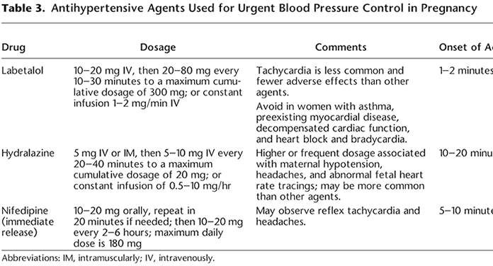
Source: ACOG Practice Bulletin #203 page 35

Slide 3
MAGNESIUM ADMINISTRATION See Contraindications and Alternatives below.
  Administering Magnesium with an IV
    Loading dose or seizure:
      Administer Magnesium sulfate [40g/liter] with a 4-6g IV bolus over 20min, use with infusion pump
    Maintenance: 1-2g/hr
    Monitor:
      Intake and output, consider placement of foley catheter
      Reflexes, if depressed -> concern for magnesium toxicity, no established therapeutic level, concern if respiratory or cardiovascular depression
      BP Q15-30 min and continuous fetal monitoring
    Concern for Mg toxicity: treat with calcium gluconate 10%, give 10cc IV over 2 minutes
    Repeat seizure: Re-bolus w/6g bolus and increase drip to 3g/hr
    Duration: Mg should be continued until 12- 24hr postpartum depending on clinical scenario or 24hr after last seizure – whichever has the longest duration

Slide 4
  Administrating Magnesium w/o an IV
    Loading dose or if seizing:
1. Magnesium sulfate 50% give 5g IM (10mL) in each buttock (10g total)*
    Maintenance: Magnesium sulfate 50% give 5g IM (10mL) every 4- 6 hours*
    * Add Lidocaine 1% 1mL to each injection to minimize discomfort
    Monitor:
      Intake and output, consider placement of foley catheter
      Reflexes, if depressed -> concern for magnesium toxicity
      No established therapeutic level, concern if respiratory or cardiovascular depression
      BP Q15-30 min and continuous fetal monitoring
    Concern for Mg toxicity: Treat with calcium gluconate 10%, give 10cc IV over 2 minutes
    Repeat seizure: repeat loading dose
    Duration: Mg should be continued until 12- 24hr postpartum depending on clinical scenario or 24hr after last seizure – whichever has the longest duration

Slide 5
ALTERNATIVES TO MAGNESIUM Contraindications to MagS04:
Myasthenia gravis, hypocalcemia, moderate to severe renal failure, cardiac ischemia, heart block, or myocarditis.
Use with caution in pulmonary edema
Consult with OB/GYN.
In setting of contraindication to Mg or no Mg available:
Lorazepam 2-4mg IV x 1, repeat once in 10-15 min if persistent seizure
Diazepam 5-10mg IV Q 5-10min; max dose 30mg

Slide 6
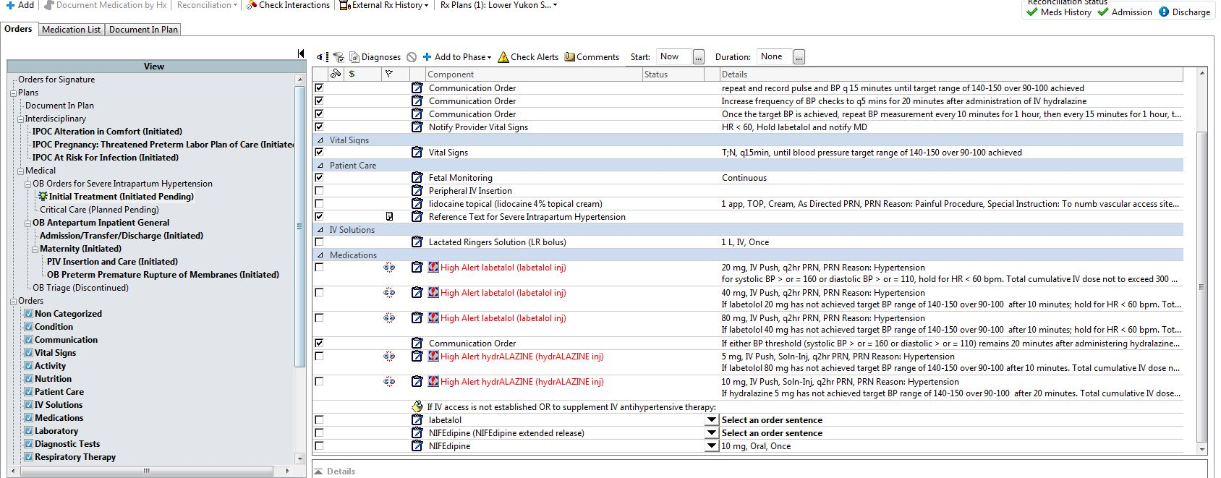

Slide 7
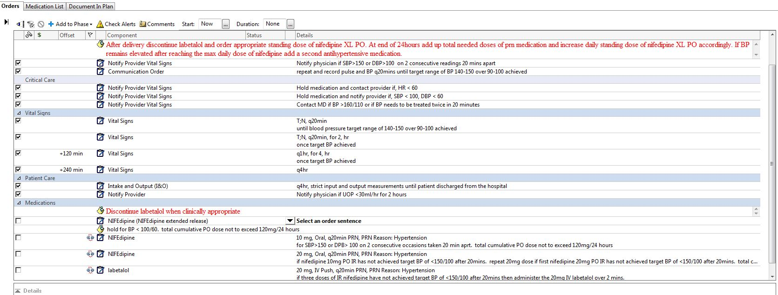

Slide 8
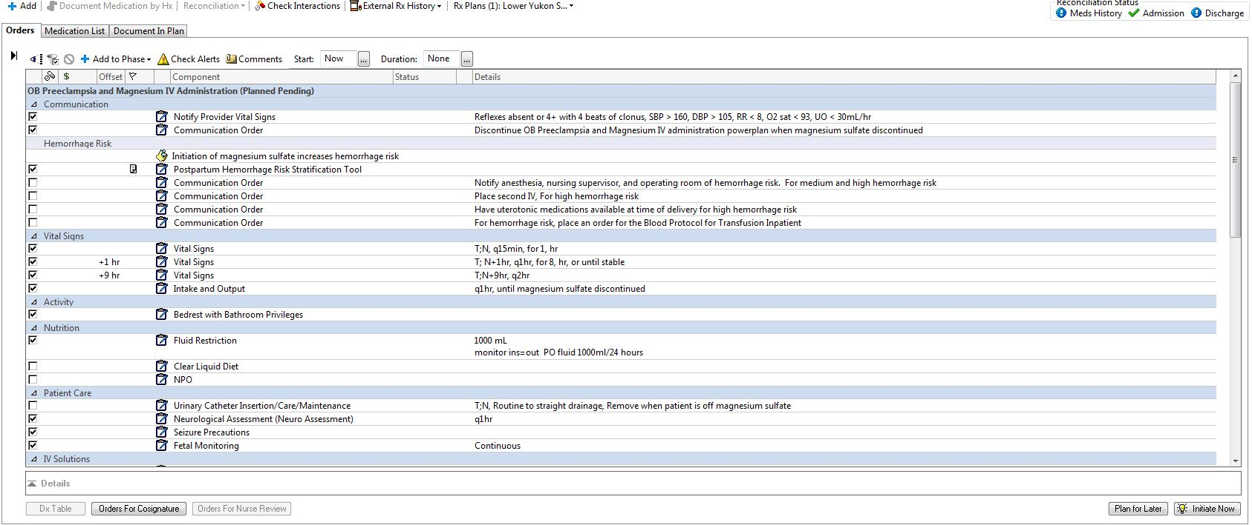

Slide 9
