Slide 1
Current Landscape of Alaska Maternal Child Health Data
Margaret Young, MPH
MCH Epidemiology Unit Manager
Section of Women’s, Children’s, and Family Health
Alaska Perinatal Quality Collaborative Launch, January 25, 2019

Slide 2



BRINGING IT TOGETHER: KEY EFFORTS to SAVE LIVES
Maternal Mortality Review Committees conduct detailed reviews to get complete and comprehensive data on maternal deaths to prioritize prevention efforts.
MMRCs
Alliance for Innovation on Maternal Health moves established guidelines into practice with a standard approach to improve safety in maternity care.
AIM
PQCs
Perinatal Quality Collaboratives mobilize state or multi-state networks to implement quality improvement efforts and improve care for mothers and babies.
Notes:
We know we need more data to help prevent maternal deaths. Maternal Mortality Review Committees – MMRCs – are one way to get more data.
MMRCs are essential. But they are one piece.
We have to know what is killing moms in our communities and identify prevention recommendations.
But then those recommendations have to be implemented. Often state-based PQCS or Perinatal Quality Collaboratives drive state change, by looking at available data, like that from MMRCs, and working to rapidly make changes to address the issues. CDC currently funds 13 PQCs, and a National Network to work with all, but they can be an important driver of quality improvement and are the infrastructure of change.
And another key piece is the AIM work on maternal safety bundles. AIM provides the toolkit of what needs to be done.

Slide 3
Maternal Child Death Review (MCDR)
Maternal Cases
Annual Reviews of prior year deaths
Out of Hospital Infants
Full Review
Monthly Reviews
Children 1-18
Full Review
Monthly Reviews
Medical Review (Can be referred to full review)
Semi/Annual Reviews
In Hospital Infants
Notes:
The Alaska Maternal Child Death Review (MCDR) Committee reviews all deaths of women while pregnant or within one year of the end of pregnancy, due to any cause.
OLD NOTES:
MCDR goals:
Review all pregnancy-associated, infant, and child deaths that occur within the state of Alaska, or among Alaskan residents.
Identify which deaths are preventable.
Find points of possible intervention.
Use this information to prevent similar deaths.
The Maternal Child Death Review program uses data from case reviews to develop substantive public health recommendations around policy, program and practice changes that would directly reduce mortality of mothers, infants, and children.
The program facilitates on-going committee reviews of most infant, child, and maternal deaths that occur in the state or to Alaskan residents. Case files are created for every death that include information from the birth and death certificates, autopsy report, death scene investigation, applicable medical records, and other sources. Every month, a multidisciplinary committee reviews cases to identify preventable causes and contributing factors, including barriers and system issues. The review committee is made up of professionals and child advocates who possess knowledge and experience relating to infant and child health and welfare. Members have expertise in a variety of areas relevant to infant and child health including neonatology and perinatology, family practice, obstetrics/gynecology, pediatrics, pathology and social work. Most states have some form of a child death review committee, either at the state or local level.

Slide 4
Alaska Maternal Deaths per Year
Source: Alaska Maternal Child Death Review
Notes:
This is all pregnancy-associated deaths – those that occurred within a year of pregnancy. No clear trend in the number of these occurring annually over the past 10 years. The most we’ve had in one year is 15, with as little as 5 a year.

Slide 5
Unintentional drug or alcohol overdose was the most common cause of the 56 Alaskan maternal deaths that occurred 2012-2017.
Source: Alaska Maternal Child Death Review
Notes:
The majority of maternal deaths in Alaska over the past 6 years were not directly related to the pregnancy. This is true about prior years as well.
In addition, the committee also found that drug or alcohol abuse or substance use disorders contributed to 52% of maternal deaths and mental health conditions contributed to 30%.

Slide 6
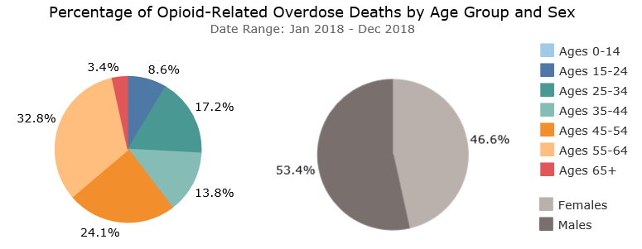
Percentage of Alaska Opioid-Related Overdose Deaths by Age Group and Sex
Source: Alaska Opioid Data Dashboard. Available at http://dhss.alaska.gov/dph/Director/Pages/heroin-opioids/data.aspx
Notes:
These pie charts just give some of the context for the pregnancy-related deaths. Among all opioid-related overdoes deaths in Alaska during 2018, about a third (blue and teal) were among people of child-bearing age, and almost half were women.

Slide 7
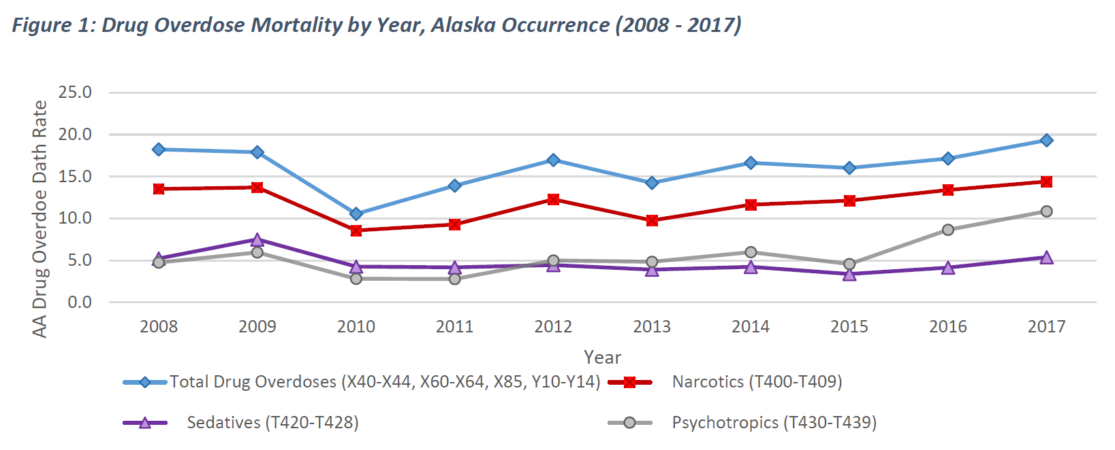
Opioid-Related Overdose Deaths
(2.2%)
(2.2%)
Source: HAVRS, 2017 Drug Overdose Mortality Update (http://dhss.alaska.gov/dph/VitalStats/Documents/PDFs/2017_Drug_OD_Data%20Brief.pdf)
Notes:
We also know that opioid-related overdose deaths have been increasing.

Slide 8
Pregnancy-related mortality rates per 100,000 births
Source: Alaska Maternal Child Death Review
Notes:
2014 most recent date available for US. Since 1987 the US rate has been rising fairly constantly from 7.2 per 100,000 in 2087 to the most recent rate of 18.0 per 100,000. Alaska’s pregnancy-related mortality rate appears to be increasing,* but is lower than the US.

Slide 9
Primary Causes of Death
Alaska pregnancy-related deaths, 2012-2017
Infection: bacterial sepsis (two cases, 29%)
Hypertensive diseases of pregnancy: preeclampsia/ HELLP syndrome (two cases, 29%)
Cardiac failure: 1 secondary to a maternal congenital heart defect and 1 with pregnancy-induced hypertension (two cases, 29%)
Pulmonary embolism (one case, 14%)
Source: Alaska Maternal Child Death Review
Notes:
Among all 7 cases of pregnancy-related death 2012-2017, these were the primary causes of death.

Slide 10
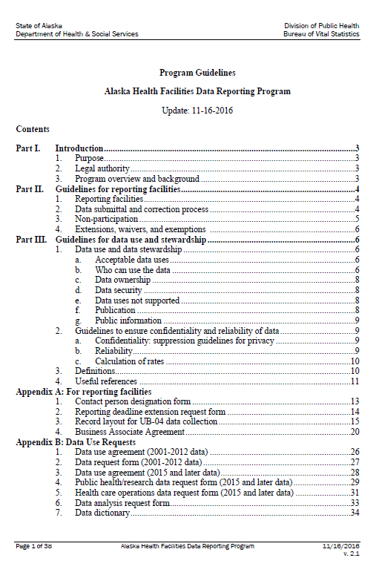
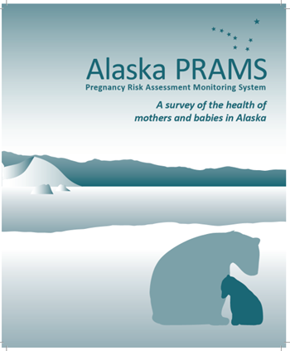
Sources for Birth Data
Notes:
Besides looking at the deaths, we also are really interested in looking at all births, to identify trends or disparities in risk factors for death as well as poor birth outcomes that may have occurred even if the child or mother didn’t die. I’ll next be talking about some of those birth data that we have available to us, and this slide shows the primary sources for this information – birth certificates, the Alaska Pregnancy Risk Assessment Monitoring Survey (sent to a sample of mothers for about 1 out of every 6 live births in the state), and the Alaska Health Facilities Data Reporting System.
I tried to select indicators that came up as topics of greater interest in the survey that probably most of you filled out last fall.

Slide 11
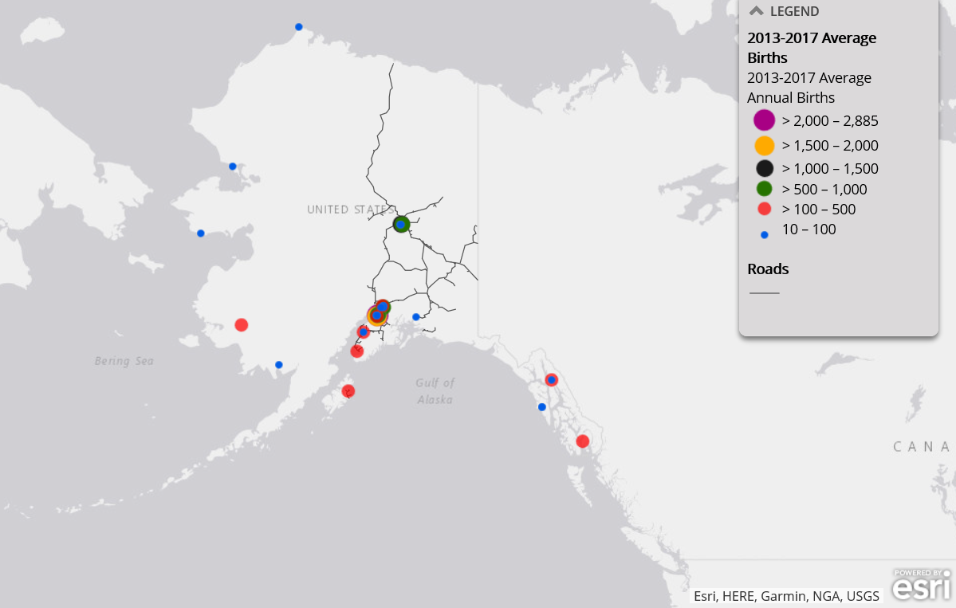
Source: Alaska Health Analytics and Vital Records Section, interactive map available online at https://arcg.is/1v1yjW0
Notes:
First, just to give a frame of reference for births, this map illustrates the location of birth based on average annual births during 2013-2017. This is a screen grab from an online resource that we recently created – see link at bottom. There were 33 birthing facilities, including 20 hospitals, with an average of 10 or more annual births during 2013-2017. At these 33 facilities, the average number of annual births ranged from 13 to 2,885.
There were an additional average of 243 annual births (2.2%) at other in-state facilities (including home births) and 145 at out-of-state facilities that are not included on these maps.
In the online version, you can zoom in on various regions of the state to get more detail than is possible to see here, if you are interested.

Slide 12
Heart Failure During Procedure or Surgery
*only includes first two quarters of 2017
Data Source: Alaska Health Facilities Data Reporting System
Notes:
The components include 16 diagnosis-based categories and 4 procedure-based categories.
Excludes transfusion.
If these data don’t look correct to you, remember that the system is only as good as the information put into it.
One SMM event that is not captured in these data is hemorrhage, due to the fact that it is very difficult to accurately measure this with only ICD codes. However, next I wanted to share a quote from a PRAMS respondent regarding her experience when she hemorrhaged shortly after giving birth. We are sharing these quotes for the first time at this meeting so that we can keep the patient voice and experience in mind, and I’ve included some others later in this presentation. If by any chance you think you are able to identify the patient based on what she says, please help us maintain her confidentiality and do not disclose this to others.

Slide 13
“I bled out completely and had to have a full body transfusion of blood 30 minutes after my daughter had arrived, I was in the ICU for a day or 2 all by myself. I never got to hold my baby till the 2nd day. Short story I almost died while having a c section. The doctors couldn't figure out what caused me to bleed so much. I stayed in the hospital for about 5-6 days. I also lost 25 pounds within 2 weeks of having my daughter. I am very happy to be alive & thank you guys for sending me this survey.”
Notes:
Next I’m going to be talking about some other specific perinatal issues

Slide 14
Neonatal Abstinence Syndrome (NAS)
Rate per 1,000 live births
Alaska NAS Rate per 1,000 Medicaid Eligible Live Births
*preliminary data
Source: Alaska Medicaid claims and Alaska Health Analytics and Vital Records
Notes:
Infants with NAS were identified by ICD-9-CM and ICD-10-CM codes for “Drug Withdrawal Syndrome in Newborn” (779.5 and P96.1) occurring within 28 days of birth.

Slide 15
Substance Use During Pregnancy
~July 2017 – April 2018 births
Among 770 women screened with the 4 P’s Plus tool:
4.4% used prescription medicines such as oxycodone (Percocet), hydrocodone (Vicodin), codeine, methadone, Subutex, Suboxone, Lortab, Norco, Buprenorphine, Fentanyl, morphine, antidepressants, or A.D.D medicines, such as Ritalin.
5.1% used any drugs such as heroin, amphetamines, cocaine, crack or methamphetamines.
4.7% used prescription medicines…
3.0% used any drugs…
In the month prior to knowledge of pregnancy
In the month prior delivery
Source: Alaska Prenatal Screening Program
Notes:
Data from 4 P’s Plus (mid 2017-mid 2018), from four hospitals located in Fairbanks, Palmer, Anchorage and Juneau.
The 4P’s Plus Screen for Behavioral Health Risk©, developed and validated by Dr. Ira Chasnoff and National Training Institute Upstream, is a five-question screening tool designed to identify pregnant women at risk of harmful substance use. The 4P’s© screening questions are categorically sequenced as follows: Parents, Partner, Past and Pregnancy. Questions about the woman’s parents and partner’s use of substances are asked to help establish a normative approach to the asking of sensitive questions about substance use. The woman is then asked about her own use of substances prior to her knowledge of her pregnancy.
The American College of Obstetricians and Gynecologists (ACOG), Substance Abuse and Mental Health Services Administration (SAMSHA), and American Academy of Pediatrics (AAP) recommend that routine prenatal care include SBIRT using tools, like 4Ps Plus©, for all pregnant women during their first prenatal visit. Universal screening of all pregnant women reduces the risk of failing to identify some and may help reduce stigma around discussing substance use in health care settings.

Slide 16
Any Substance Use in the Month Prior to Delivery (N=770)
Source: Alaska Prenatal Screening Program

Slide 17
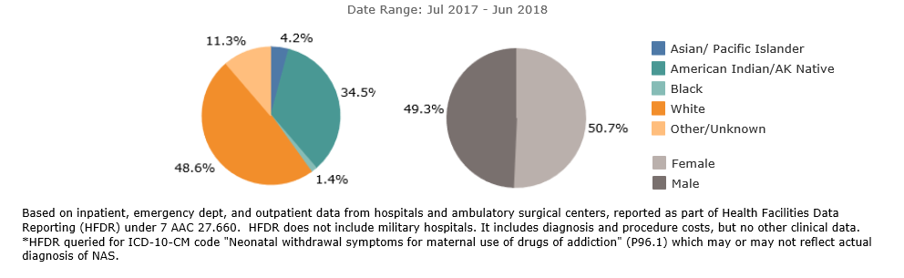
Race and Sex of Newborns with NAS
Source: Alaska Opioid Data Dashboard. Available at http://dhss.alaska.gov/dph/Director/Pages/heroin-opioids/data.aspx
Notes:
Focus on the race data
These data are from the Health Facilities Data Reporting system

Slide 18
“During my pregnancy, I was taking Subutex. Before pregnancy & at the beginning, I was only on 1 mg, but by the end it had to increase to 16 mg. My doctor and OBGYN did not think it would affect the baby, but 2 days after delivery, he was showing signs of withdrawal. He was sent to [name] and we were there for a painful 32 days! My OBGYN was completely surprised by how long he was there, and we were too. We were constantly being given apologies for how under-trained the nurses were for the scoring of the methadone program they put him on. We 100% believe that he could have been out after 1-2 weeks if it wasn't for the undertrained nurses in [name]. A horrible experience that I will never forget!”

Slide 19
Self-reported Postpartum Depressive Symptoms, 2016
% women delivering live births
Source: Alaska Maternal Child Health Data Book 2018: PRAMS Edition
Notes:
Women respond to Alaska PRAMS on average 4.5 months after delivery, and answer questions about their postpartum care and experiences.
PRAMS asks women how often they felt down, depressed or hopeless since their new baby was born and how often they had little interest or little pleasure in doing things they usually enjoyed since their new baby was born. Responses of always or often to either question were counted as experiencing postpartum depressive symptoms.
The percent of Alaska women who recently delivered a live birth and reported postpartum depressive symptoms was the same as the percent of all U.S. women (13%).

Slide 20
Postpartum Checkup Provider Asked If Mom was Feeling Down or Depressed, 2016
% women delivering live births
Source: Alaska Maternal Child Health Data Book 2018: PRAMS Edition
Notes:
Depression screening (provider asked if she was feeling down or depressed) during a postpartum visit was reported by 80% of women, and was significantly more likely to be reported by White women and women not in poverty compared to women of other races and women in poverty.

Slide 21
“…I have a history of depression and still did not find or have offered any prenatal resources that were useful, even though I expressed my history to my health care providers. In my experience, it seems even the providers have a lack of experience, info. or understanding themselves. Thank you for your work in this survey taking!”
Notes:
Depression quote

Slide 22
Neonatal and Post-neonatal Infant Mortality rates: Alaska & U.S., 2000-2017
Rate per 1,000 live births
Source: Alaska Health Analytics and Vital Records Section & National Vital Statistics system, National Center for Health Statistics (NCHS), U.S. Centers for Disease Control and Prevention (CDC)

Slide 23
Sudden Unexplained Infant Death (SUID) in Alaska
Source: Alaska Health Analytics and Vital Records Section
Notes:
Just to give you an idea of the number of SUID deaths per year, over the past 11 years, Alaska has had 10-32 SUID deaths each year based on death certificate data. The percent of all infant deaths that are SUID has ranged from 17% to 42%. In most years, Alaska’s SUID rates have been higher than the US SUID rates.

Slide 24
Risk Factors in SUID Deaths (N=32)
2016-2017
28% caregiver impaired
  55% alcohol
  22% drugs
66% of infants were found in an adult bed, 13% on a couch, 13% in a crib/bassinet
81% were sharing a bed with an adult or other children
50% of infants found on their stomach, 34% on their back, 13% on their side
Source: Alaska Maternal Child Death Review
Notes:
32 SUID deaths during 2016-2017 have been reviewed by the MCDR committee. 83% of these were postneonatal.

Slide 25
Infant always or often slept alone in the past 2 weeks in his or her own crib or bed*, 2016
% women delivering live births
Source: Alaska Maternal Child Health Data Book 2018: PRAMS Edition
Notes:
Women respond to Alaska PRAMS on average 4.5 months after delivery, and answer questions about their postpartum care and experiences.
This is the new Title V indicator that combines info from several questions. It is not a straightforward yes/no.
Combines information from questions that ask how often the infant slept alone AND where the baby usually sleeps

Slide 26
Percentage of births with no prenatal care in the first trimester, 2013-2017
Source: Alaska Health Analytics and Vital Records
Notes:
According to birth certificate data, statewide, about one in five births, 20%, have no prenatal care in the first trimester. This varies somewhat by mothers region of residence, from 15% in the Southeast, to 29% in the Southwest

Slide 27
Use of a most or moderately effective contraceptive method postpartum, 2016
% women delivering live births*
FPL = Federal Poverty Level
*Note: Non-pregnant women excluding those who indicated they wanted to get pregnant and those who reported not being sexually active. Methods considered “most or moderately effective” are sterilization,
Implant, IUD, Depo-Provera, pills or patch/ring.
Source: Alaska Maternal Child Health Data Book 2018: PRAMS Edition
Notes:
Among women who are sexually active and not currently seeking another pregnancy, use of a most or moderately effective contraceptive method ranged from 54.3% in the Southeast region to 70.0% in the Fairbanks/Interior region. None of the differences between regions were significant, however.
No national comparison available for this one.

Slide 28
Any breastfeeding at 8 weeks, 2016
% women delivering live births
Source: Alaska Maternal Child Health Data Book 2018: PRAMS Edition
Notes:
Alaska has very high breastfeeding initiation rates (95% overall in 2016). Has been increasing.
Alaska’s 8-week breastfeeding rate of 83% far exceeds the U.S. comparison at 66%. Even the demographic groups that have lower rates in Alaska (<25 years, Alaska Native or races other than White, or lower FPL) all exceed the overall U.S. value.

Slide 29
Exclusive breastfeeding at 8 weeks, 2016
% women delivering live births
Source: Alaska Maternal Child Health Data Book 2018: PRAMS Edition
Notes:
No national comparison available for this one
Nearly two-thirds (64%) of Alaska women breastfed exclusively at 8 weeks postpartum in 2016.

Slide 30
“My baby was born perfectly healthy at 39 weeks. She only weighed 5lbs, 5oz. My doctor said that she didn't appear to be gaining weight in the last part of the pregnancy, so I was induced…. She is doing great now and has been gaining weight properly. We exclusively breast feed. She is 3 months old and weighs over 9lbs now. New moms should be told during pregnancy that breastfeeding is not easy at first. It took 5 weeks of issues before my baby and I figured out how to do it correctly. It was awful. It was painful. She wouldn't latch correctly. I had oversupply. She had thrush. It was miserable. I wanted to quit but I felt guilty about wanting to quit. I had a lot of support. I talked to a lactation consultant. It got better. Now we have it figured out and are doing great, but in the beginning I almost quit. I'm glad I didn't.”
Notes:
Breastfeeding quote

Slide 31
BRINGING IT TOGETHER: KEY EFFORTS to SAVE LIVES
Maternal Mortality Review Committees conduct detailed reviews to get complete and comprehensive data on maternal deaths to prioritize prevention efforts.
MMRCs
Alliance for Innovation on Maternal Health moves established guidelines into practice with a standard approach to improve safety in maternity care.
AIM
PQCs
Perinatal Quality Collaboratives mobilize state or multi-state networks to implement quality improvement efforts and improve care for mothers and babies.
Notes:
We know we need more data to help prevent maternal deaths. Maternal Mortality Review Committees – MMRCs – are one way to get more data.
MMRCs are essential. But they are one piece.
We have to know what is killing moms in our communities and identify prevention recommendations.
But then those recommendations have to be implemented. Often state-based PQCS or Perinatal Quality Collaboratives drive state change, by looking at available data, like that from MMRCs, and working to rapidly make changes to address the issues. CDC currently funds 13 PQCs, and a National Network to work with all, but they can be an important driver of quality improvement and are the infrastructure of change.
And another key piece is the AIM work on maternal safety bundles. AIM provides the toolkit of what needs to be done.

Slide 32

Thank you!
Margaret.young@Alaska.gov
(907) 269-5657
Notes:
By the way, there are hard copies of the PRAMS data book out on the table outside, if any of you are interested in a copy, and it is also available online.

