Slide 1
Severe Hypertension in Pregnancy and ED
Sarah Truitt, MD and Leanne Komorowski, MD
Southcentral Foundation
Alaska Native Medical Center
March 2020

Slide 2
Learning Objectives
Learn about severe range blood pressures in pregnancy and postpartum
Review the risks of untreated severe hypertension in pregnancy or postpartum
Review how to take a blood pressure in a postpartum or pregnant woman
Learn what blood medications are first line for severe hypertension in pregnancy or postpartum
Discuss Magnesium seizure prophylaxis
Review current ANMC guidelines for ED triage of the OB patient

Slide 3
Why do we care?
Risk reduction, improved clinical outcomes
16% of maternal deaths in US due to HTN
Stroke
Systolic HTN: hemorrhagic strokes
Confidential Enquiries 2005
– 54 % died with systolic HTN vs 13% with diastolic HTN

Slide 4
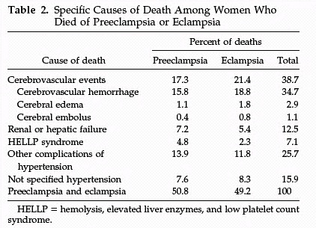
Cause of U.S. Maternal Mortality
4024 maternal deaths
790 (19.6%) from preeclampsia
CDC Review of 14 years of coded data: 1979-1992
90% of CVA were from hemorrhage
MacKay AP, Berg CJ, Atrash HK. Obstetrics and Gynecology 2001;97:533-538
Notes:
We have made no progress with regard to preventing maternal death from hemorrhagic cerebral vascular accidents.

Slide 5
What needs immediate RX?
Systolic > 160
or
Diastolic > 110
Persistent for 15 minutes

Slide 6
Need
To
Treat*
BP ≥
160/110
*BP persistent 15 minutes, activate treatment algorithm with IV therapy ASAP, < 30-60 minutes

Slide 7
What are our goals?
Treatment within 30-60 min to decrease stroke
Our goal is NOT a normal BP
Our goal is 140–150/90–100 mm Hg
Prevent loss of cerebral vasculature autoregulation
Avoid endotracheal intubation in acute phase, if possible

Slide 8
How to measure?
Accurate measurement
Correct size cuff
Mercury sphygmomanometer: gold standard
Validated equivalent automated equipment
Correct positioning
sitting or semi-reclining position with the back supported
not to be repositioned to reclining - which decreases BPs

Slide 9
Treatment: 3 first line agents
IV Labetalol
Rapid onset, less tachycardia and adverse side effects
Avoid in women with active asthma*
Avoid in pre-existing myocardial disease, decompensated cardiac function, heart block, bradycardia, or CHF
Caution: history of asthma
Causes neonatal bradycardia
Hold if pulse < 60 bpm
Max 220 mg / 24 hrs
*‘Active’ asthma:
-Sx at least once a week, or
-Current use of inhaler, corticosteroids
-Any hx of intubation for asthma

Slide 10
Treatment: 3 first line agents
IV or IM Hydralazine
Risk of maternal hypotension, headaches, abnormal fetal tracings
Max dose of 25 mg / 24 hrs
Oral nifedipine (Immediate release tab)
Reflex tachycardia and headaches
May overshoot hypotension
Immediate release oral nifedipine capsules should be administered orally, NOT punctured or sublingually because of risk of hypotension.
Max dose of 180 mg / 24 hrs

Slide 11
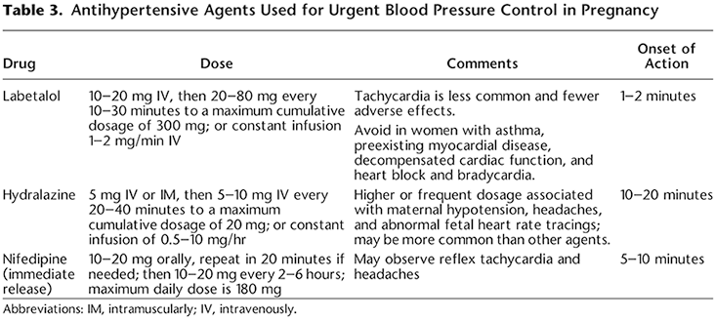

Slide 12
Ordersets
Highly recommended: OB orders for severe hypertension at ANMC
Standardizes care at facility
One overall orderset vs 3 separate ordersets
Labetalol IV 20, 40, 80, q 10 min then Hydralazine 5, 10, 10 q 20 min
Hydralazine IV 5, 10, 10, q 20 min then Labetalol 20, 40, 80 q 10 min
Nifedipine PO 10, 20, 20, q 20 min then Labetalol IV 40, 80 q 10 min

Slide 14
Ordersets: A few caveats….
-ACOG Practice Bulletin # 202 (Table 3)
Hydralazine dosing should be 5-10 mg q 20-40 min to a max of 20 mg /24 hrs.
-Safe Motherhood:
Hydralazine max 25 mg/ 24 hrs q 20 min
Suggestion: Use 25 mg / 24 hrs max, but go by 5, 10, 10 q 20 min

Slide 15
Order sets: A few caveats….
At the end of the Labetalol figure once you have given 80 of IV labetalol, your next choice is Hydralazine 10 mg
Versus
At the beginning of the Hydralazine figure, ACOG you either start at 5 mg of Hydralazine or 10 mg of Hydralazine
Suggestion: Use 25 mg / 24 hrs max, but go by 5, 10, 10 q 20 min

Slide 16
If IV access is not available:
The immediate release oral nifedipine algorithm should be first-line therapy in this setting.
If immediate release oral nifedipine is not available:
200-mg dose of labetalol can be administered orally
Same labetalol dose may be repeated in 30 minutes

Slide 17
Treatment of Resistant Hypertension
In this rare circumstance….
Emergent consultation with an anesthesiologist, maternal–fetal medicine subspecialist, or critical care subspecialist to discuss second-line intervention.
Consider:
Nicardipine
Esmolol by infusion pump

Slide 18
Treatment of Resistant Hypertension
Sodium nitroprusside should be reserved for extreme emergencies
Shortest amount of time possible
Cyanide and thiocyanate toxicity in the woman and fetus or newborn
Increased intracranial pressure with potential worsening of cerebral edema in the woman

Slide 19
Mag Seizure Prophylaxis
Magnesium is NOT an anti-hypertensive agent
Should be used for:
Seizure prophylaxis in women with severe range BPs and controlling seizures in eclampsia
IV bolus of 4-6 grams in 100 ml over 20 minutes followed by IV infusion of 1-2 grams per hour
Continue for 24 hours postpartum ▪ If no IV access
10 grams of 50% solution IM (5 g in each buttock)
Contraindications: pulmonary edema, renal failure, myasthenia gravis

Slide 20
ED Triage of OB Patients: ANMC Guidelines
Patients at 20 weeks or greater presenting whose chief complaint suggests a probability of being pregnancy-related should be referred to OB Triage for initial evaluation:
Contractions, backache, pelvic pressure
Increasing vaginal discharge or vaginal bleeding
Decreased fetal movement
Elevated blood pressure > 140/90
Postpartum patients < 3 weeks after delivery with blood pressure > 160/110

Slide 21
ED Triage of OB Patients: ANMC Guidelines
ED should keep and evaluate any patient who is pregnant regardless of gestational age who presents medically unstable such as:
Respiratory distress
Trauma
Cardiac instability
Highly contagious infection such as Influenza
OB evaluation for the status of fetal wellbeing will be performed in the ED at the discretion of the ED physician or the consulting OB physician

Slide 22
Postpartum
If postpartum BP is confirmed > 160 / 110, then treat immediately with IV labetalol, IV hydralazine, or Nifedipine Immediate Release PO if no IV access and consult OB
If postpartum BP is > 150 / 100, then:
Change anti-HTN regimen
Consult OB/GYN
If changes made, then re-appt one week
Smooth transition to primary care provider

