Slide 1
Module 3: Stewardship in Skin and Soft Tissue Infections
Benjamin P Westley MD, FAAP, FACP, FIDSA
Benjamin P Westley MD LLC
3500 LaTouche St Suite 200
Anchorage, AK 99508

Slide 2



Accreditation Statement & Disclosure
In support of improving patient care, the Alaska Department of Health is jointly accredited by the Accreditation Council for Continuing Medical Education (ACCME), the Accreditation Council for Pharmacy Education and the National Association of Boards of Pharmacy (NABP), and the American Nurses Credentialing Center (ANCC), American Academy of Physician Assistants (AAPA), American Psychological Association (APA), Association of Social Work Boards (ASWB) and the American Dental Association's Continuing Education Recognition Program (ADA CERP) to provide continuing education for the healthcare team.
AK DOH designates this activity for1 contact hour per session, 7 sessions total.
This activity has been planned and implemented in accordance with the accreditation requirements and policies of the Accreditation Council for Continuing Medical Education (ACCME) through the joint providership of the Alaska Department of Health (AKDOH) and the Alaska Hospital and Healthcare Association. AKDOH is accredited by the ACCME to provide continuing education for the healthcare team.
No commercial or in-kind support was received for this educational activity. All speakers and planners report no relevant financial relationships related to the content of this activity.
To obtain credit for this participants must watch the full hour course and complete the evaluation.

Slide 3
Objectives
Define classes of uncomplicated skin and soft tissue infection (SSTI) that drive empiric antimicrobial selection
  Purulent SSTI
  Non-purulent SSTI
Recognize conditions that suggest complications are likely and may require alteration of usual empiric regimens
Identify warning signs and clinical features of necrotizing SSTI
Discuss classes of diabetic foot infection (DFI) and appropriate initial approaches to therapy
Brief comment on SSTI in IV drug users (IVDU)

Slide 4
Skin and soft tissue infection
Multiple terms/categories
  Cellulitis/erysipelas
  Impetigo
  Abscess
  Skin and soft tissue infection (SSTI)
  Complicated skin and skin structure infection (cSSSI)
  Necrotizing fasciitis, Fournier’s gangrene
  Diabetic foot infection (DFI)
Used interchangeably, often inappropriately
Not mutually exclusive

Slide 5
Impetigo
Superficial crusting/oozing lesions, sometimes bullous
  MSSA or GAS
  RARELY MRSA
  Culture can help if multiple lesions and poorly responding to systemic therapy
Single lesions -> Topical mupirocin
Multiple/recurring lesions -> cephalexin

Slide 6
Cellulitis
Red, hot, indurated tender skin
  Multiple causes
    Edema, venous stasis, sunburn etc. can mimic cellulitis
  Red warm skin is not always infection!
  Can be non-purulent, or can surround a purulent lesion
If associated with furuncle, carbuncle, or abscess -> STAPHYLOCOCCUS AUREUS
If diffuse and unassociated with focal lesion-> BETA-HEMOLYTIC STREPTOCOCCI
Erysipelas = subset of cellulitis
  Fiery red, tender, painful plaque with well demarcated edges
    GROUP A STREPTOCOCCUS

Slide 7
2014 IDSA SSTI Guidelines¹
Categorizes SSTI by purulent/non-purulent to guide empiric coverage
If there is carbuncle/abscess or draining pus = PURULENT* :
  I+D, send culture on first episode
MILD PURULENT SSTI = NO ABX
MODERATE PURULENT SSTI = Cellulitis > 5 cm diameter
    Bactrim DS 1 BID
    Clindamycin 300mg po TID or linezolid 600mg po BID if Sulfa allergic
    Adding cephalexin to trimethoprim/sulfamethoxazole is NOT beneficial²⁶
SEVERE PURULENT SSTI = Purulent SSTI plus sepsis
    Blood cultures x 2
    Vancomycin dosed to goal trough of 10-15
    PO once source controlled and improved to complete 7d Rx
5 day duration as effective as 10 days²⁴
*Cellulitis associated with penetrating trauma or IVDU should be considered “purulent”

Slide 8
Are antibiotics really needed for uncomplicated abscess?
Data are conflicting….⁴⁻⁶
  2 prior RCT suggest not
  NEJM studies published 2016 and 2017²⁵ suggest small benefit

Slide 9
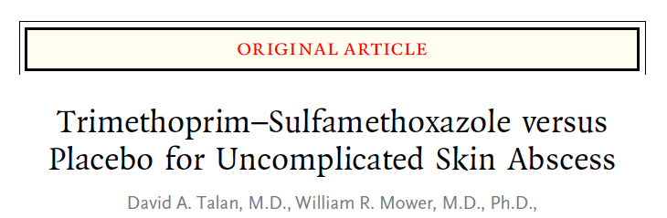
1265 patients ≥12y old with abscess ≥2cm randomized to TMP/SMX 320/1600 bid vs placebo x7 days⁴
All received I+D with cultures
Average abscess 2.5cm with cellulitis of 6cm
45.3% MRSA
Cure rate higher with ABX than placebo by ~7%
  ABX 80.5% vs. Placebo 73.6% (P=0.005)
N Engl J Med 2016;374:823-32.

Slide 10
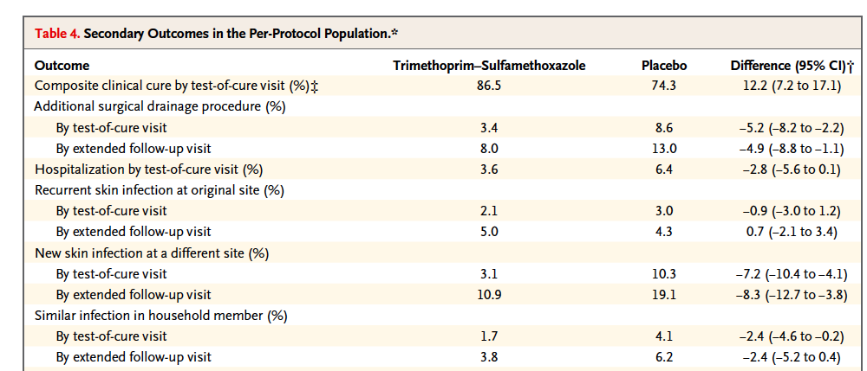
N Engl J Med 2016;374:823-32.

Slide 11
Non-purulent cellulitis
MILD
  Cephalexin or amoxicillin 1g PO TID
MODERATE
  Cefazolin 1-2g iv q8h
  If not improving after 48-72h, evaluate for evolution of unrecognized purulent focus and consider ID consult and/or adding protein-synthesis inhibitor
SEVERE
  Evaluate for necrotizing infection
  Broad abx

Slide 12
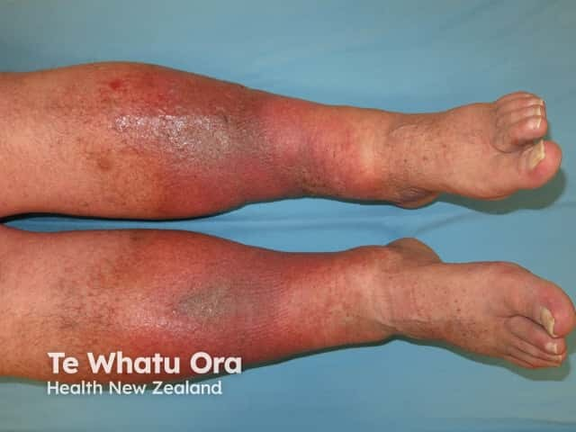
Not all red legs are infected!
Venous stasis dermatitis
Often symmetric, waxes/wanes when dependent
Mild tenderness
Subacute onset, no fever or systemic symptoms; NO ABX!!

Slide 13
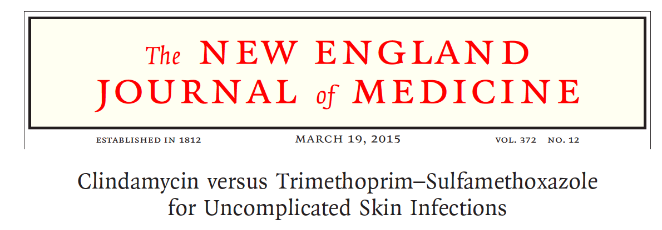
Randomized controlled trial, 524 patients²
  Children and adults
  Half (46%) with purulent disease
Bactrim DS BID vs. Clindamycin 300mg TID x 10 days
Equivalent cure rates and complication rates
MODERATE DISEASE
  Excluded T > 38.5C (adults) and 38.0C (children)
N Engl J Med 2015;372:1093-103

Slide 14
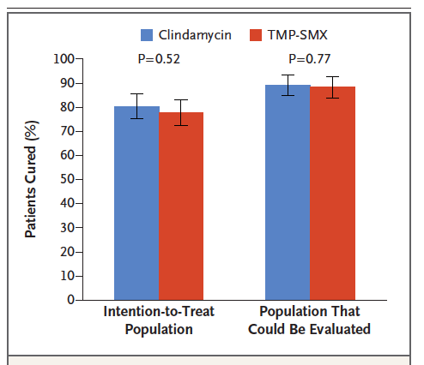
N Engl J Med 2015;372:1093-103

Slide 15
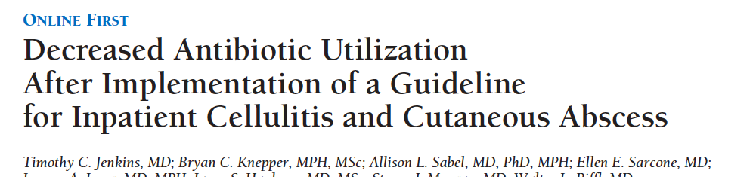
169 patient pre-guideline vs. 175 post-guideline³
Interventions:
  Selective CRP, x-ray, blood cx use
  ESR, superficial cultures, CT or MRI imaging DISCOURAGED
  Vancomycin, total Rx IV + PO 7 days
    Doxycycline, clindamycin, or bactrim on discharge
  Broad aerobic GNR or anaerobe coverage DISCOURAGED
  NSAID and elevate legs
Arch Intern Med. 2011;171(12):1072-1079.

Slide 16
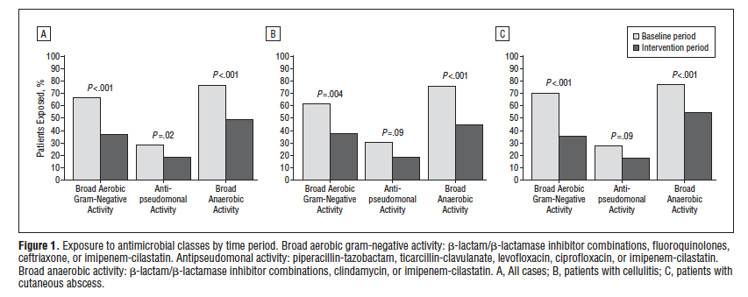
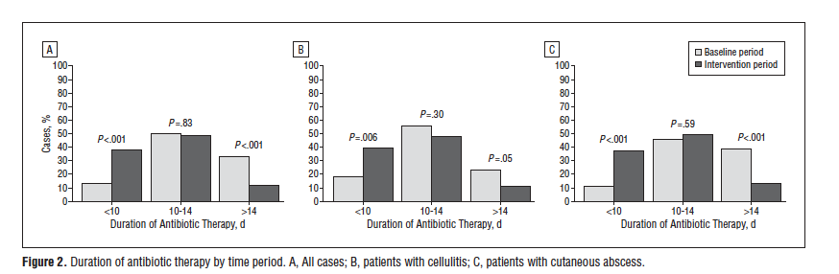
Arch Intern Med. 2011;171(12):1072-1079.
Notes:
Median duration 13 -> 10 days. Sig decrease in CT/MR imaging, blood cx

Slide 17
Conditions that increase risk of complications
Periorbital cellulitis
  Occasionally mixed flora due to sinus-process
Breast cellulitis
  May appear non-purulent but often staphylococcal or due to obstructed duct with skin flora and may require surgery
Parotid or head/neck abscess
  Staphylococcal and mixed oral flora
Perirectal/perineal/genital infection
  Often mixed staphylococcal and GI flora
Immune compromise
  Transplant, chemotherapy, immuno-modulatory agents
  Seek ID input

Slide 18
Necrotizing SSTI¹
Necrotizing fasciitis
  Death of tissues along superficial fascial planes
2 forms
  Monomicrobial, usually group A strep (Type II)
    30 – 80% mortality^{1,10}
  Polymicrobial (GNRs and anaerobes; Type I)
Hallmark features (1 or more)
  Pain out of proportion to visible lesion
  Woody subcutaneous tissues rapidly expanding
  Systemic toxicity (LRINEC score)
  Crepitus
  Skin necrosis, ecchymosis, and/or bullous lesions

Slide 19
Fournier’s gangrene
Subtype of polymicrobial necrotizing fasciitis involving the scrotum/vulva
Spreads from peri-rectal or perineal lesion
Enteric mixed flora including clostridium

Slide 20
LRINEC Score⁷
Laboratory Risk Indicator in Necrotizing Fasciitis
WBC, Na, glucose, creatinine, and CRP
Score >6
  92% PPV
  96% NPV
Score ≥6 in ~90% of patients with necrotizing fasciitis
  i.e. ~10% with necrotizing fasciitis are <6
Score ≥6 in 8.4% of patient WITHOUT necrotizing fasciitis
Notes:
Add link to calculator

Slide 21
LRINEC scoring
CRP
  <15 mg/dL = 0
  ≥15 mg/dL = 4
WBC
  <15 x 10³ /uL = 0
  15 – 25 x 10³ /uL = 1
  >25 x 10³ /uL = 2
Hemoglobin
  >13.5 g/dL = 0
  11 – 13.5 g/dL = 1
  <11 g/dL = 2
Sodium
  ≥135 mmol/L = 0
  <135 mmol/L = 2
Creatinine
  ≤1.6 mg/dL = 0
  >1.6 mg/dL = 2
Glucose
  ≤180 mg/dL = 0
  >180 mg/dL = 1

Slide 22
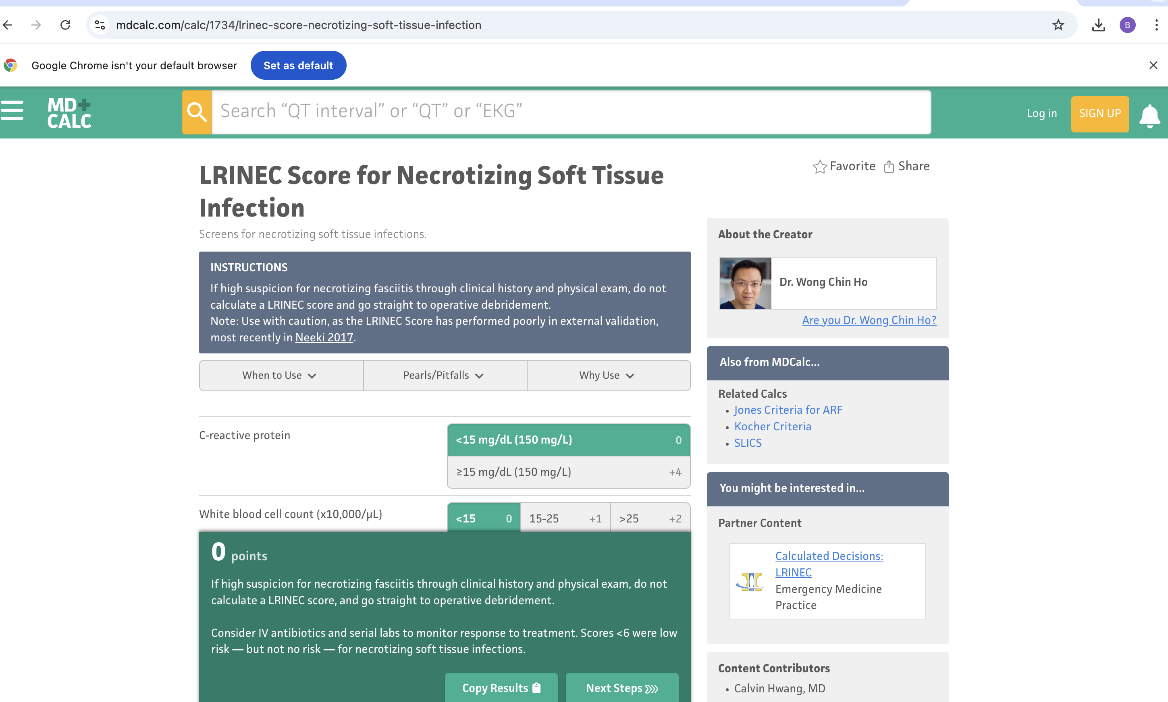
LRINEC score

Slide 23
Imaging in necrotizing fasciitis
CT and/or MRI may show fluid along fascial planes, fascial enhancement, or gas in tissues^{20,21}
Sensitivity and specificity are poor³⁰
Imaging studies tend to delay surgery
Clinical impression should drive surgical decision making
    Small incisions in area of concern made; if no fascial sloughing, necrosis or dehiscence, extensive debridement is not required

Slide 24
Toxin and Group A Strep
Clindamycin decreases in-vitro streptococcal toxic shock toxin production and improves animal survival^{12,13}
Observational data suggests clindamycin decreases mortality in invasive group A streptococcal infections^{8-10,14,17}
Linezolid also appears to impair streptococcal toxin production in vitro and is likely non-inferior to clindamycin when utilized with a beta-lactam for invasive group A streptococcal infection²⁷⁻²⁹
Clindamycin resistance among group A streptococcal isolates in Alaska is approaching 20% (CDC Arctic Investigations Program, personal communication)
Notes:
Add linezolid data/slide

Slide 25
Toxin inhibition
Use clindamycin or linezolid WITH a beta-lactam until clinically improved, then continue beta-lactam alone
  E.g. cefazolin 1-2g iv q8h then amoxicillin 1g po TID
We generally finish therapy with ~10d total Rx but duration should be based on clinical response

Slide 26
Necrotizing Fasciitis ABX
Linezolid 600mg q12h, PLUS
Piperacillin/tazobactam per local dosing protocol
AND
Immediate surgical consultation!!! It is NOT appropriate to give the above abx for presumed necrotizing infection WITHOUT emergent surgical evaluation!
Notes:
Update slide with linezolid regimen and new data

Slide 27
IV immune globulin
Suggestion of mortality benefit in group A strep infection with the toxic shock syndrome
  Multi-organ system dysfunction
  Shock
  Often, diffuse erythematous sunburn-like rash and dramatic conjunctival injection
Data is limited^{10,14-16} and conflicting²³
Dosing not well defined
  Usually 1 g/kg on day 1 then 0.5 g/kg on days 2 and 3

Slide 28
Diabetic Foot Infection (DFI)
Updated IWGDF/IDSA guideline in 2023¹⁸
Not all diabetic ulcers are infected!!
Signs of infection
  Redness, warmth, tenderness, pain, induration, or purulent secretions
MILD
  Redness ≤ 2 cm around ulcer
MODERATE
  Redness >2cm around ulcer OR deep structures involved
  WITHOUT sepsis
SEVERE
  Local infection plus SIRS criteria
IWGDF = International working group on diabetic foot
Notes:
Update guideline reference; idsa and the separate foot guidelines

Slide 29
Diabetic Foot Infection
Infected wounds in should be cultured BEFORE antibiotics are started
  Cultures should be sent from deep tissue by biopsy or curettage AFTER wound is cleaned and superficial tissues debrided
  Do NOT delay antibiotics in septic patients
All should get plain x-ray if diabetic foot osteomyelitis (DFO) suspected
MRI if high suspicion for DFO despite normal CXR, labs, and negative probe to bone
  NOT ALL DIABETIC FOOT ULCERS REQUIRE MRI

Slide 30
ABX for DFI¹⁸
MILD to MODERATE severity
  Target aerobic GPC only
  Mild = Cephalexin
  Moderate = Amoxicillin/clavulanate or ampicillin/sulbactam
    If recent MRSA: Linezolid
    If known Pseudomonas: Piperacillin/tazobactam
SEVERE
  Linezolid or vancomycin PLUS piperacillin/tazobactam
  Urgent surgical consultation
Duration (ok to use PO!!!)
  Mild: 1 – 2 weeks
  Moderate – severe: 2 – 3 weeks
  Osteomyelitis present and not fully resected: 3-6 weeks
  Osteomyelitis fully resected: 2 – 5 days
Notes:
Need NOT all be IV!!!

Slide 31
Guideline durations
“As treatment with oral antibiotic regimens for residual osteomyelitis are associated with failure rates similar to those with intravenous regimens, this may help reduce the length of hospital stay in those patients.”

Slide 33
DFI Treatment Failure/Recurrence
Usually due to inadequate offloading, vascular supply, or failure to resect poorly-viable tissues
"We suggest not using HBO therapy or topical oxygen therapy as an adjunctive treatment for the sole indication of treating a DFI.”
No data to support >6 weeks of therapy for DFO

Slide 34
Diabetic foot infection myths
“All diabetic foot ulcers should be treated with antibiotics”
  Antibiotics do not speed ulcer healing or prevent infection
“All diabetic ulcers to bone require admission for IV abx.”
  If wound to bone, will need surgery; discuss w/ foot surgeon
  Admit if severe illness or worsening cellulitis on PO abx
“All inpatient diabetic foot infections should be given vancomycin and zosyn to cover MRSA and Pseudomonas.”
  Only if septic and getting urgent surgical assessment
“All osteomyelitis requires a picc line and 6 weeks of IV abx.”
  FALSE. FALSE. FALSE.

Slide 35
Systematic review shows NO benefit of antimicrobials without wound debridement and soft tissue coverage
Exposed bone often NOT infected, MRI NOT accurate
Wound care evaluation and assess for closure
If acute soft tissue cellulitis around wound, treat for 7 days and STOP unless bone proven infected and wound to be closed
If osteomyelitis confirmed and wound closed, treat with PO for 2 weeks if cortical bone and 4-6 weeks if medullary bone infection
³¹Clin Infect Dis 2019;68(2):338–42

Slide 36
SSTI in IV Drug Users
Possibly decreasing frequency in Alaska due to fentanyl and correlated decrease in injecting drug use
Many users lick needles and/or injection sites and use non-sterile diluent
Usual presentations:
  Antecubital fossa abscess
  Cellulitis with phlebitis
  Necrotizing fasciitis²²
Beta-strep and/or MSSA/MRSA PLUS oral flora^{19,22}
  Streptococcus anginosus group
  Haemophilus/Eikenella
  Prevotella/Fusobacterium
Literature suggests Vancomycin monotherapy is adequate^{1,19}
  We often add ampicillin/sulbactam for severe SSTI in IVDUs
Notes:
Mention linezolid if not septic

Slide 37
SSTI in IVDU
Consult chemical dependency service if available OR:
Consider instructing patients about safe injection techniques
  Use chlorhexidine/antisepsis
  Don’t touch site
  Don’t lick site or needles
  Don’t re-use/share needles
  Provide information on needle exchange
Screen for HIV, HBV/HCV, and syphilis/STIs
Offer pre-exposure prophylaxis for HIV (PREP)
If using opiates, recommend a naloxone rescue kit

Slide 38
Evaluation & CE Certificate
AK DOH designates this activity for 1 contact hour per session, 7 sessions total.
To obtain credit for after finishing the one-hour course, please register on Moodle and complete the evaluation. Once the evaluation is complete you will be able to download your certificate.
Evaluation Link through the Moodle State of Alaska DOH and DFCS Training
If you need to create a Moodle Login/account follow this link and these directions.

Slide 39
References
Clin Infect Dis. 2014 Jul 15;59(2):147-59
N Engl J Med 2015;372:1093-103.
Arch Intern Med. 2011;171(12):1072-1079.
N Engl J Med 2016;374:823-32.
Ann Emerg Med 2010;55: 401-7.
Ann Emerg Med 2010; 56: 283-7.
Crit Care Med. 2004 Jul;32(7):1535-41.
Pediatr Infect Dis J 1999; 18:1096–100.
South Med J 2003; 96:968–73.
Clinical Infectious Diseases 2014;59(3):358–65
Clinical Infectious Diseases 2014;59(3):366–8
J Antimicrob Chemother 1997; 40:275–7.
J Infect Dis 1988; 158:23–8.
Clinical Infectious Diseases 2014;59(6):851–7
Clin Infect Dis 1999; 28:800–7.
Clin Infect Dis 2003; 37:333–40.
J Infect Dis 1988; 158:23–8.
Clin Infect Dis 2023. https://doi.org/10.1093/cid/ciad527
Acad Emerg Med. 2015 Aug;22(8):993-7.
Clinical Radiology (1996) 51, 429-432
Am J Roentgenol. 1998 Mar;170(3):615-20.
Clinical Infectious Diseases 2001; 33:6–15
Clinical Infectious Diseases 2017 Apr 1;64(7):877-885
Arch Intern Med 2004; 164:1669–74
N Engl J Med 2017 Jun 29;376(26):2545-2555
Open Forum Infect Dis. 2017 Fall; 4(4): ofx232.

Slide 40
References
Open Forum Infectious Diseases, Volume 10, Issue 12, December 2023, ofad588, https://doi.org/10.1093/ofid/ofad588
Clin Infect Dis. 2023 Jan 13;76(2):346-350
Lancet Infect Dis 2024. https://doi.org/10.1016/S1473-3099(24)00507-3
Joint Bone Spine. 2013 Mar;80(2):146-54.
Clin Infect Dis 2019;68(2):338–42

