Slide 1
Severe Hypertension in pregnancy
Neil Murphy MD
Southcentral Foundation
Alaska Native Medical Center
February 2020

Slide 2
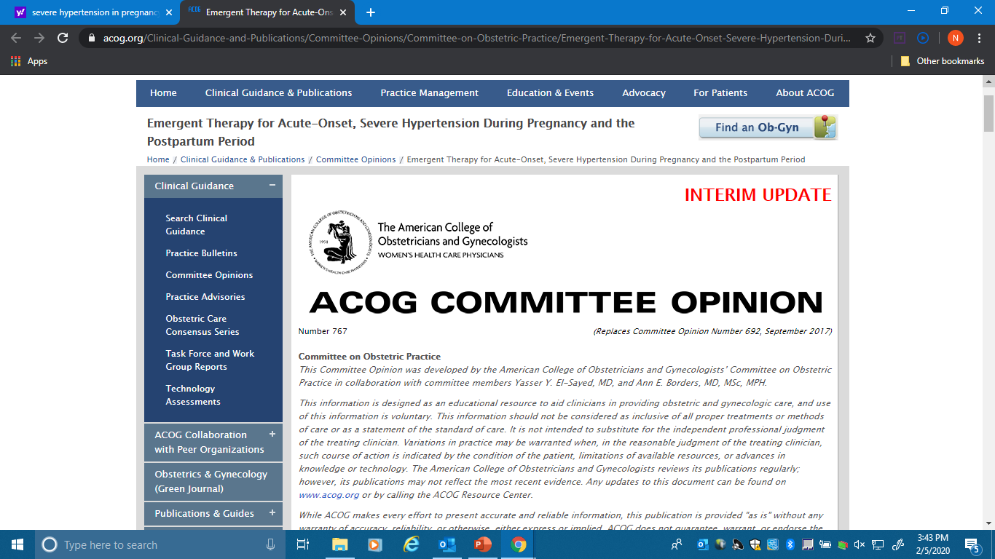

Slide 3
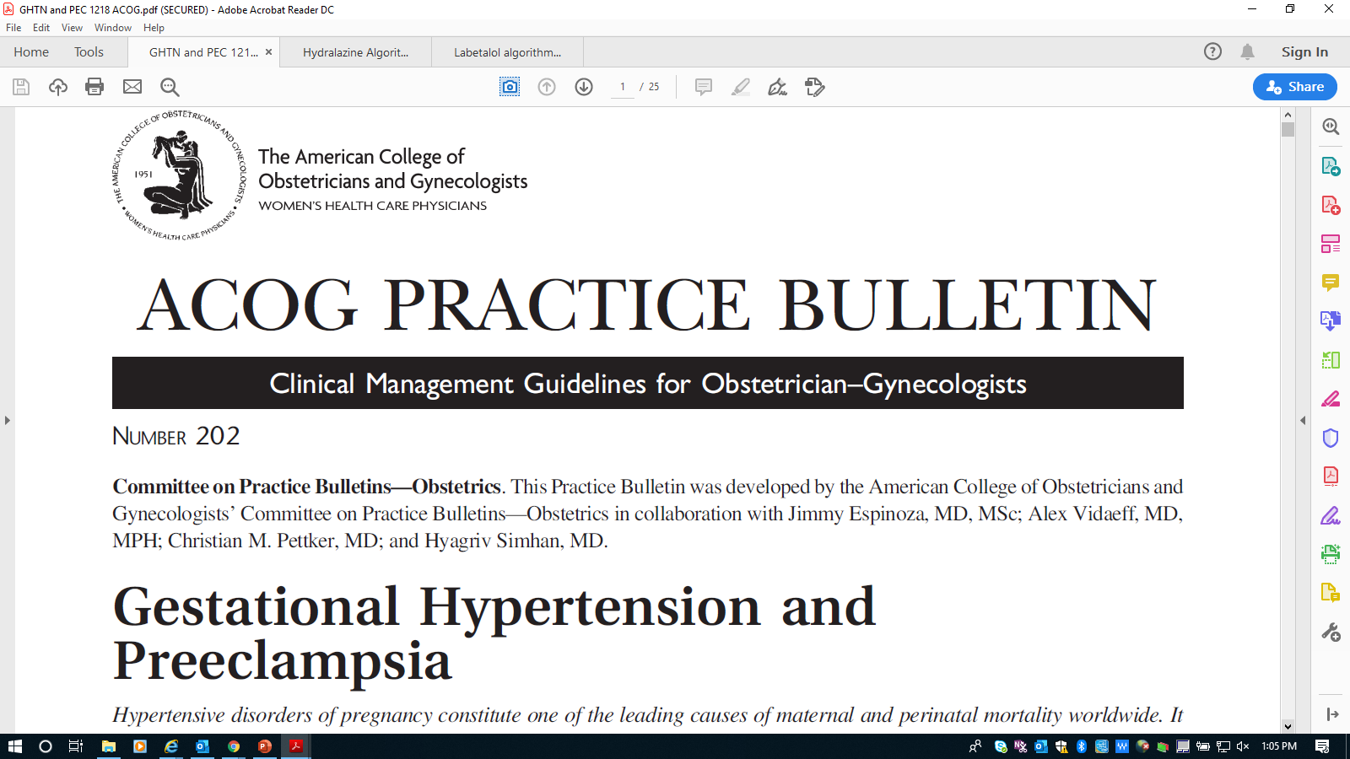

Slide 4
Why do we care?
Risk reduction, improved clinical outcomes
16% of maternal deaths in US due to HTN
Stroke
  Systolic HTN: hemorrhagic strokes
  Confidential Enquiries 2005
    – 54 % died with systolic HTN vs 13% with diastolic HTN

Slide 5
What is it?
Systolic > 160
or
Diastolic > 110
Persistent for 15 minutes

Slide 6
What are our goals?
Treatment within 30-60 min to decrease stroke
Our goal is NOT a normal BP
Our goal is 140–150/90–100 mm Hg
  Prevent loss of cerebral vasculature autoregulation
Avoid endotracheal intubation in acute phase, if possible

Slide 7
How to measure?
Accurate measurement
  Correct size cuff
  Mercury sphygmomanometer: gold standard
  Validated equivalent automated equipment
Correct positioning
  sitting or semi-reclining position with the back supported
  not to be repositioned to reclining - which decreases BPs

Slide 8
Treatment: 3 first line agents
  IV Labetalol
    Rapid onset, less tachycardia and adverse side effects
    Avoid in women with active asthma*
    Avoid in pre-existing myocardial disease, decompensated cardiac function, heart block, bradycardia, or CHF
    Caution: history of asthma
    Causes neonatal bradycardia
    Hold if pulse < 60 bpm
    Max 220 mg / 24 hrs
    *‘Active’ asthma:
    -Sx at least once a week, or
    -Current use of inhaler, corticosteroids
    -Any hx of intubation for asthma

Slide 9
Treatment: 3 first line agents
  IV or IM Hydralazine
    Risk of maternal hypotension, headaches, abnormal fetal tracings
    Max dose of 25 mg / 24 hrs
  Oral nifedipine (Immediate release tab)
    Reflex tachycardia and headaches
    May overshoot hypotension
    Immediate release oral nifedipine capsules should be administered orally, NOT punctured or sublingually because of risk of hypotension.
    Max dose of 180 mg / 24 hrs

Slide 10
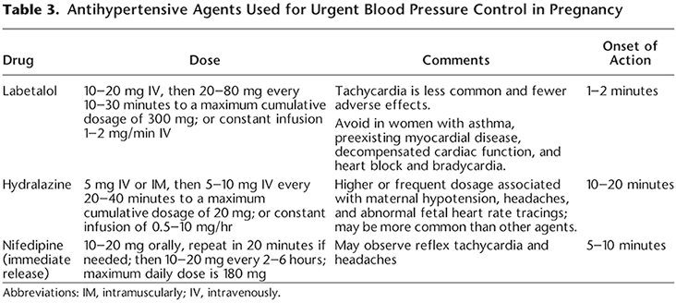

Slide 14
Ordersets
Highly recommended
Standardizes care at facility
One overall orderset vs 3 separate ordersets
Labetalol IV 20, 40, 80, q 10 min then Hydralazine 5, 10, 10 q 20 min
Hydralazine IV 5, 10, 10, q 20 min then Labetalol 20, 40, 80 q 10 min
Nifedipine PO 10, 20, 20, q 20 min then Labetalol IV 40, 80 q 10 min

Slide 15
Ordersets: A few caveats….
-ACOG Practice Bulletin # 202 (Table 3)
Hydralazine dosing should be 5-10 mg q 20-40 min to a max of 20 mg /24 hrs.
-Safe Motherhood:
Hydralazine max 25 mg/ 24 hrs q 20 min
Suggestion: Use 25 mg / 24 hrs max, but go by 5, 10, 10 q 20 min

Slide 16
Ordersets: A few caveats….
At the end of the Labetalol figure once you have given 80 of IV labetalol, your next choice is Hydralazine 10 mg
Versus
At the beginning of the Hydralazine figure, ACOG you either start at 5 mg of Hydralazine or 10 mg of Hydralazine
Suggestion: Use 25 mg / 24 hrs max, but go by 5, 10, 10 q 20 min

Slide 17
If IV access is not available:
The immediate release oral nifedipine algorithm should be first-line therapy in this setting.
If immediate release oral nifedipine is not available:
  200-mg dose of labetalol can be administered orally
  Same labetalol dose may be repeated in 30 minutes

Slide 18
Treatment of Resistant Hypertension
In this rare circumstance….
Emergent consultation with an anesthesiologist, maternal–fetal medicine subspecialist, or critical care subspecialist to discuss second-line intervention.
Consider:
  Nicardipine
  Esmolol by infusion pump

Slide 19
Treatment of Resistant Hypertension
Sodium nitroprusside should be reserved for extreme emergencies
Shortest amount of time possible
Cyanide and thiocyanate toxicity in the woman and fetus or newborn
Increased intracranial pressure with potential worsening of cerebral edema in the woman

Slide 20


