Slide 1
National Partnerships with the AIM Alliance
Jeanne Mahoney
Sr. Director - AIM

Slide 2
AIM GOAL Eliminate Preventable Maternal Mortality and Severe Morbidity in Every U.S. Birthing Facility
AIM STRATEGIES
BROAD PARTNERSHIP
TOOLS & TA
IMPLEMENTATION TRAINING
REAL TIME DATA
BUILD ON EXISTING INITIATIVES
INCREMENTAL BUNDLE ADOPTION

Slide 3
AIM Works at National, State,
and Facility Levels for Implementation
National PH and Professional Organizations
Perinatal Collaborative: DPH, Hospital Assoc., Professional Groups
Hospitals, Providers, Nurses, Offices,
and Patients
Community Maternal Health Service Providers and MCH Organizations
Engage/coordinate national partners and resources
Support multi-state data platform
Support/coordinate hospital efforts
Use state data for outcome metrics
Create QI Team to Implement bundles
Review progress through AIM Data Portal
Increase access to care through promotion of collaborative and unfragmented maternal care.
Engage public voice

Slide 4
IMPROVING POPULATION HEALTH OF WOMEN
Maternal Mortality Review Committees conduct detailed reviews to get complete and comprehensive data on maternal deaths to prioritize prevention efforts.
MMRCs
Alliance for Innovation on Maternal Health moves established guidelines into practice with a standard approach to improve safety in maternity care.
AIM
PQCs
Perinatal Quality Collaboratives mobilize state or multi-state networks to implement quality improvement efforts and improve care for mothers and babies.
Zaharatos, CDC,2018

Slide 5
Accomplishments of AIM Partnership
1
Created a multidisciplinary and interagency collaboration among states, hospitals, and health systems
2
Developed harmonized, data-driven, continuous quality improvement processes
3
Streamlined bundle implementation utilizing evidence-based resources
4
Provided intensive technical assistance, education, and training across states, hospitals, and health systems

Slide 6
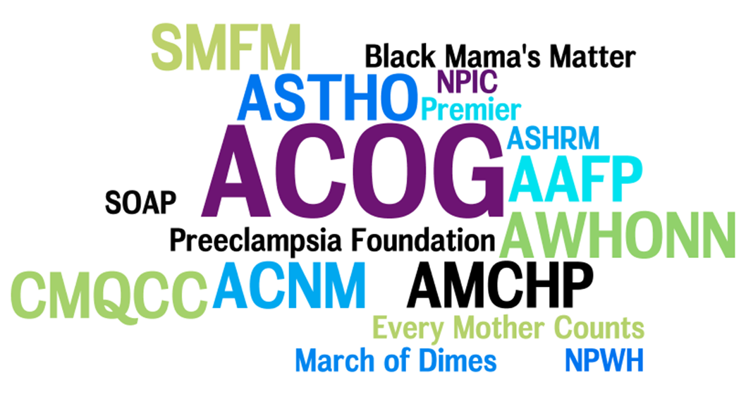
The Alliance 2018
American Hospital Assoc.
ASAM
PCHHC
NICHQ
Genetic Alliance
Healthy Start
WIC
ABOG
HRSA
City MatCH
Trinity Health Care
Emergency Nurses

Slide 7
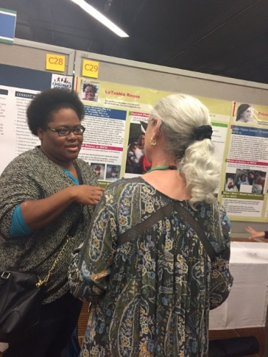
Patients belong on EVERY partnership and State Team
LaToshia Rouse (Patient Partner)
She’s a patient partner for the American Congress of Obstetricians and Gynecologists, American Board of Pediatrics, Perinatal Quality Collaborative of North Carolina, and WakeMed Health and Hospitals in Raleigh, NC.
AIM is an opportunity to share her experience as a patient partner as well as discuss the issues facing women with the people who are improving their care.

Slide 8
Every Partner Contributes
AWHONN – Postpartum discharge teaching; connect AIM state AWHONN leaders.
ACNM – Birthtools web info, Leadership on Supporting Intended Vaginal Birth
AMCHP – Maternal mortality review web tools; focus on disparities
ASTHO – Engages state health officers to provide strong support.
AAFP – Content on bundle work groups and consultation for rural state issues.
ABOG – Portfolio MOC
AHA – Entre into hospital “C” Suites
Emergency Nurses – Improve postpartum triage in critical access facilities
Healthy Start – Provide wrap around services for pregnant/postpartum women
MOD – State chapters reach deep into communities
NPWH – Workgroup leadership, community focus, path for nursing CEUs
SOAP – Consultation on bundle implementation and disparities
SMFM – M in MFM; leadership and mentorship on state teams.
WIC - Identify dangerous prenatal and postpartum warning signs and refer

Slide 9
AIM Partners on EVERY Bundle Workgroup
Obstetric Hemorrhage
Severe Hypertension in Pregnancy
Safety Bundless
Maternal VTE Prevention
Safe Reduction of Primary Cesarean Births
Obstetric Care of Women with Opioid Dependence
Maternal Early Warning Criteria
For
Every
Mother
Reducing Disparities in Maternity Care
Postpartum Care Basics
Safety Tools
SMM Case Review Forms
Maternal Mental Health
Transition to well woman care
Patient, Family and Staff Support
9

Slide 10
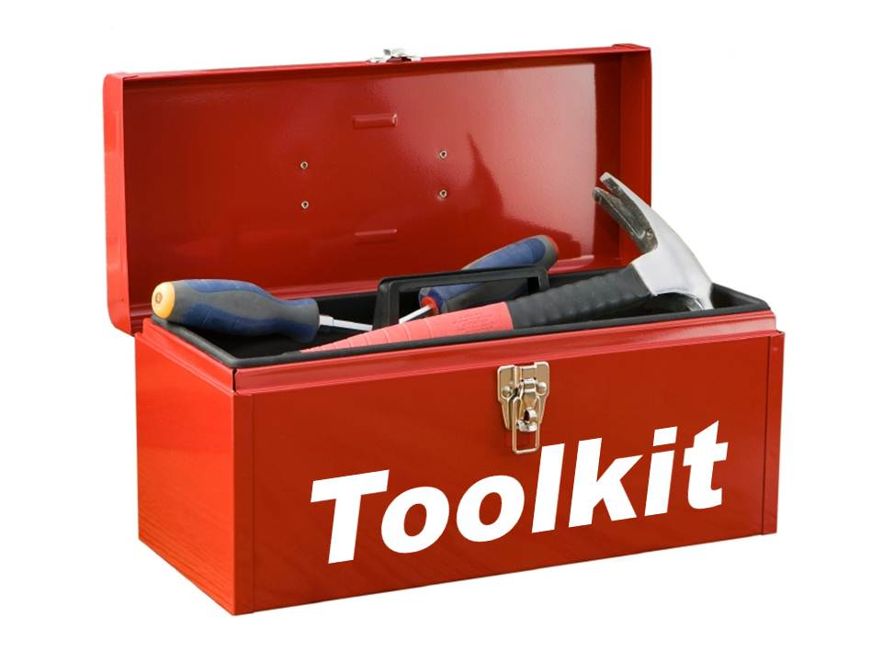
Support state teams
Monthly and ad hoc calls with team members
Mentorship between state teams
Identify and address common issues – Examples:
Treating severe level HTN
Shortages and misappropriations of critical pharmaceuticals
Supporting quantification of blood loss
Tool Kits
E-modules
Resource platform – Contact AIM
Safety Action webinars
AIM Implementation Tools

Slide 11
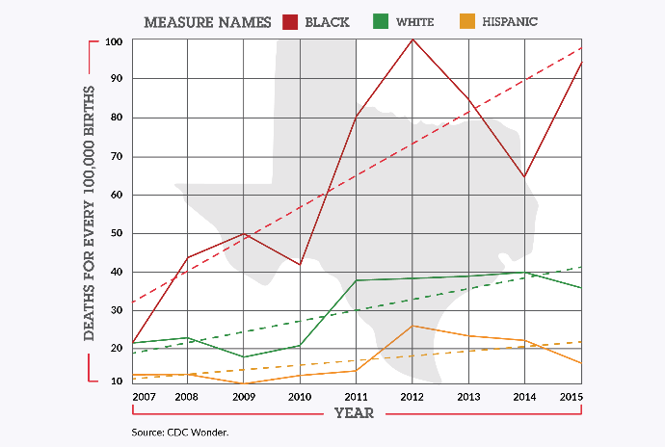
AIM Keeping Current with Issues
Implementing Maternal Opioid Use Bundle
14 state teams built tool kit
Clinical pathways, webinars, metrics
Support MAT training for OB providers
Reducing Maternal Racial Disparities
Workgroups for bundle implementation
Women’s voices/Ask for your life
States and Partners Identify Themes
Identify and share strategies on shortages of critical drugs such as labetalol and hydralazine
Share need for emergency departments to improve triage of pregnant and postpartum women
Identify ECHO and other distance learning strategies

Slide 12
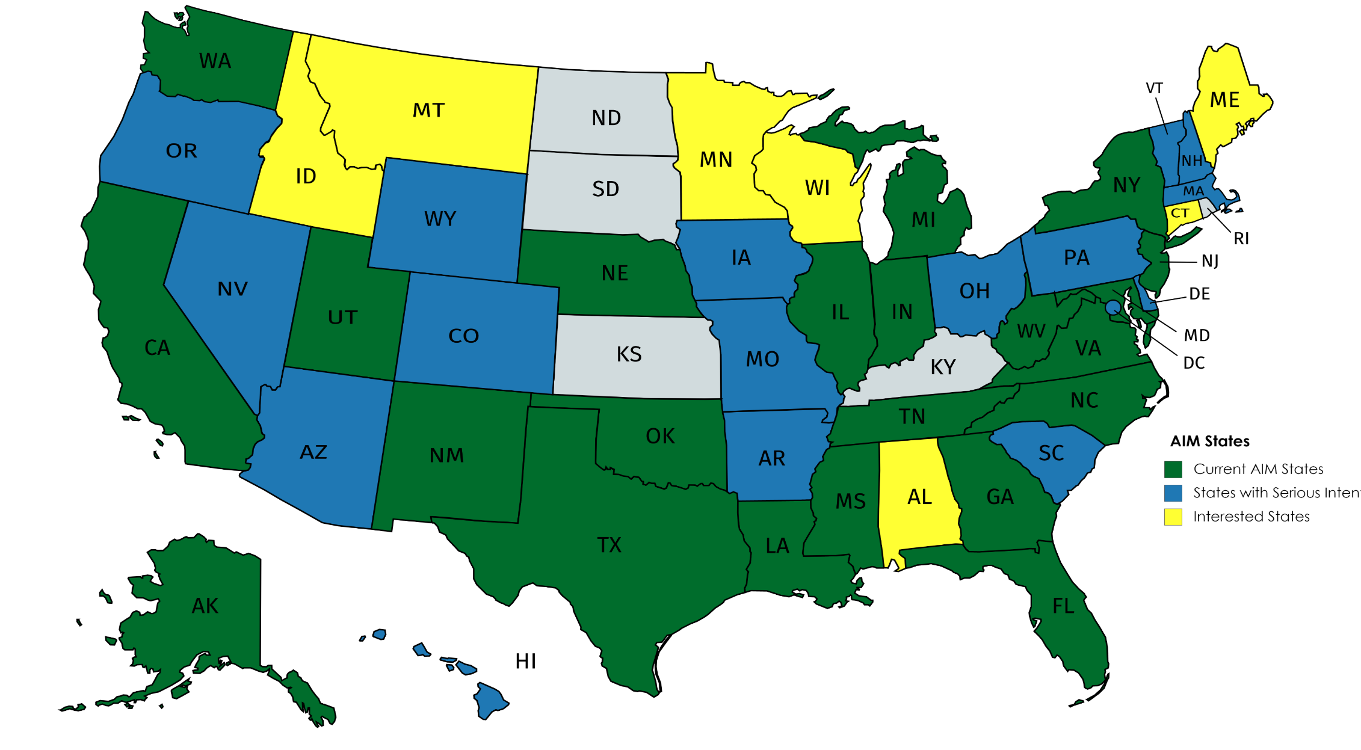
AIM Program January 2018
https://safehealthcareforeverywoman.org/aim-program/

Slide 13
AIM Impact
Initial “Class of 2015” (CA, FL, IL, MI, OK)
5 States
8.3 to 22.1% decrease in Severe Maternal Morbidity
California: Reduction of SMM from Hemorrhage
In 126 Participating hospitals: -20.8%
In 48 Control hospitals: -1.2%
Illinois: Treatment of Severe Hypertension
In 102 Participating hospitals:
Timely treatment (<60min) rose from 14% to 71%
SMM among HTN patients fell from 15% to 9%

Slide 14
Current AIM Initiatives
Bundle implementation guides and bundle commentaries
Obstetric care of women with opioid use disorder
Reduction of peripartum Racial Disparities/ Clinical Community linkages
AHRQ initiated work: Building Team STEPPS into bundles
Data analysis and enhanced technical assistance
Engagement of emergency department clinicians
Refreshing and disseminating current e-learning modules
Hospital participation recognition program
Engagement of Indian Health Service & DoD

Slide 15
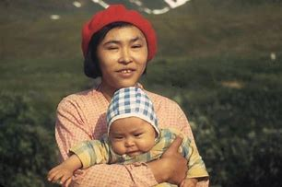
Made in Alaska AIM

Slide 16
CONTACT:
www.safehealthcareforeverywoman.org/AIM
Thank You
Jeanne Mahoney
jmahoney@acog.org

